Slide 1
Property
Class #17
April 11, 2016

Slide 2
Feedback from Surveys
Please go over the assignments more afterward (particularly the future interest questions)
Please give us more detail about what you are looking for ahead of time.
Not fair to get new assignments when we haven’t gotten the earlier ones back yet.
Why are you such a harsh grader?
Not fair that you seem laid back but then grade harshly.
I learned a lot doing the rewrite.
I learned nothing doing the rewrite.

Slide 3
Assignment #2 (found property)
Lost, Mislaid, Abandoned
Two main questions
How do you know which category to put the bracelet in?
What are the implications of these categories? i.e., if you determine that it is lost, what does that mean for ownership?
Different points allocations based on what side you were writing for.
Laura – doesn’t really care whether it is lost of mislaid. That just explains who holds onto it for her. She needs to establish not abandoned
Michael – strongest to argue it was abandoned. Wants to argue it is lost and he is first finder. (independent contractor)
Tico – if lost, he gets as Michael’s employer. If mislaid, he gets as owner of locus in quo

Slide 4
Grammar!
That vs. which
When to capitalize “court”
Parallel construction
Wordiness and legalese
In order to
Utilize
Passive voice

Slide 5
Exam
Topics on the Exam
Topics NOT on the exam
Concurrent Ownership
Landlord Tenant
Real covenants, equitable servitudes, & nuisance
Zoning, Eminent Domain, Takings
Adverse Possession
Found Property
Gifts
Easements
Future Interests

Slide 6

Real Covenants
Promises
Enforceable at law
Requirements
In Writing
Intent
Touch and Concern
Privity (Horizontal and Vertical)
Notice

Slide 7
Equitable Servitudes
Intent
Original parties intent the benefit and burden to run with the land
Notice
Actual or constructive
Required for the Burden to run
Touch and Concern the Land
Same rules as for real covenants
No privity required

Slide 8
Fink v. Miller
Utah 1995
p. 727/741

Slide 9
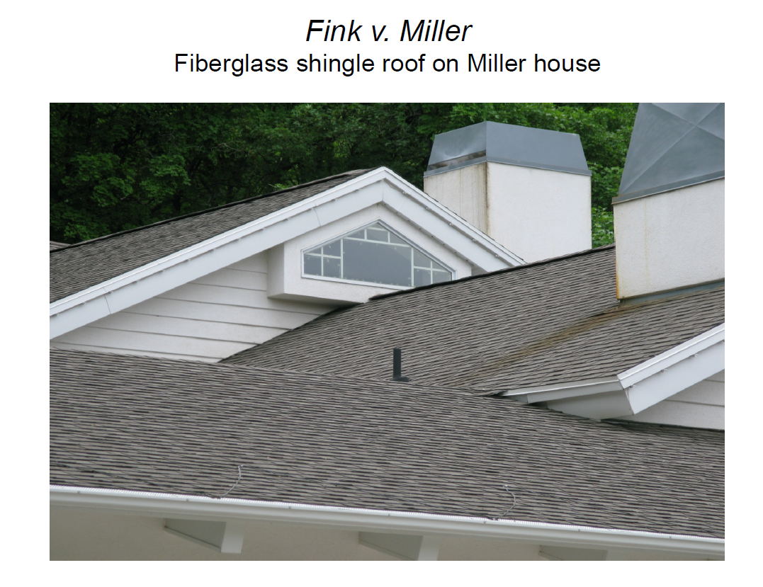

Slide 10
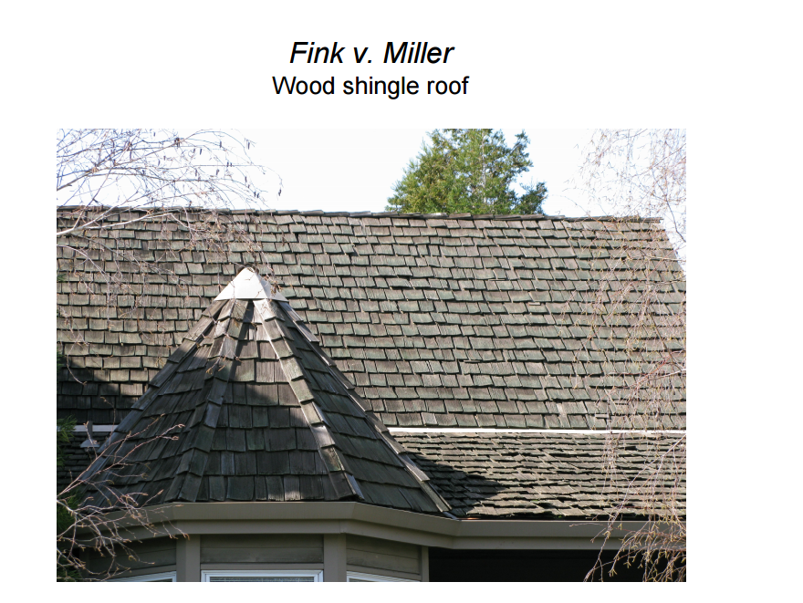

Slide 11
Vernon Township Volunteer Fire Department, Inc. v. Connor
Pennsylvania 2004
p. 732/746

Slide 13
Doctrine of Changed Conditions
The original purpose of the restriction has been materially altered or destroyed by changed conditions, and that a substantial benefit no longer extends to Appellants by enforcement of the restriction

Slide 14

Schaefer v. Eastman Community Association
New Hampshire 2003
p. 740/754

Slide 15

Fountain Valley Chateau Blanc Homeowner’s Association v. Department of Veterans Affairs
California 1998
p. 746/760

Slide 16
CC&Rs
Owners are required to “maintain the interior of their residential units, including the interior… floors… in a clean, sanitary and attractive condition.”

