Slide 1
Property
Class #15
April 4, 2016

Slide 2
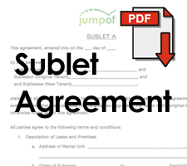
Subleases and Assignments
Assignment
T2 steps into T1’s shoes.
USUALLY – T2 pays rent to LL
Sublet
T1 and T2 have a side deal that may or may not mirror the lease.
USUALLY - T1 pays rent to LL and T2 pays rent to T1

Slide 3

Ernst v. Conditt
Tennessee 1964
p. 483/501

Slide 4
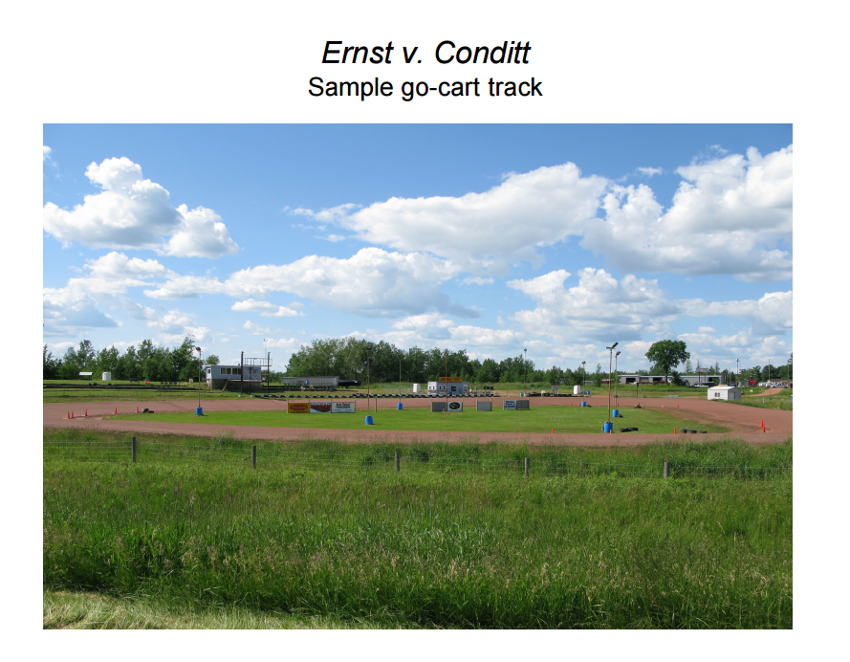

Slide 5
Case Timeline
June 18, 1960: Ernst lease to Rogers for 1 y and 7 days
July 1960, Rogers begins negotiating with Conditt for a sale of the business
Conditt wants a two-year lease
Conditt and Rogers negotiate an extension of the lease
Rogers transfers his interest to Conditt
August to November, Conditt operated the track and paid rents directly to the Ernsts for August, September, and October
Ernsts contact Rogers in December and complain about the lack of November rent
Rogers argues that he doesn’t owe the Ernsts, but 5 months later gave them 1 month’s rent
Ernsts sue Conditt for rent due and cost of taking out the track

Slide 6
Original Lease
Lessee shall have no right to assign or sublet the leased premises without prior written approval of Lessors. In the event of any assignment or sublease, Lessee is still liable to perform the covenants of this lease, including the covenant to pay rent, and nothing herein shall be construed as releasing Lessee from his liabilities and obligations hereunder

Slide 7
Renegotiated Lease
Lessor hereby consents to the subletting of the premises to A.K. Conditt, but upon the express condition and understanding that the original Lessee, Frank K. Rogers, will remain personally liable for the faithful performance of all terms and conditions of the original lease and of this amendment to the original lease.

Slide 8
Sublease
For the value received and in consideration of the promise to faithfully perform all conditions of the within lease as amended, I hereby sublet the premises to A.K. Conditt upon the understanding that I will individually remain liable for the performance of the lease. … Rogers
The foregoing subletting of the premises is accepted… Conditt

Slide 9
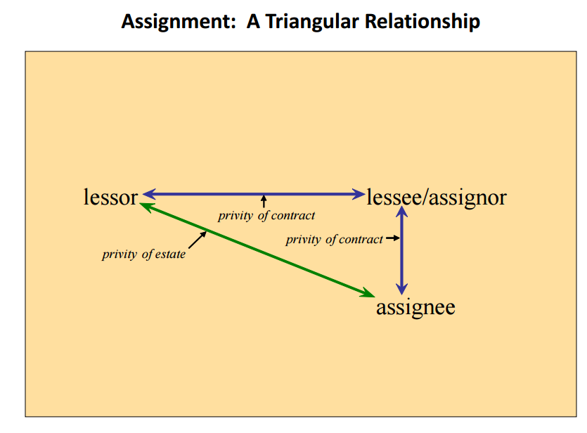

Slide 10
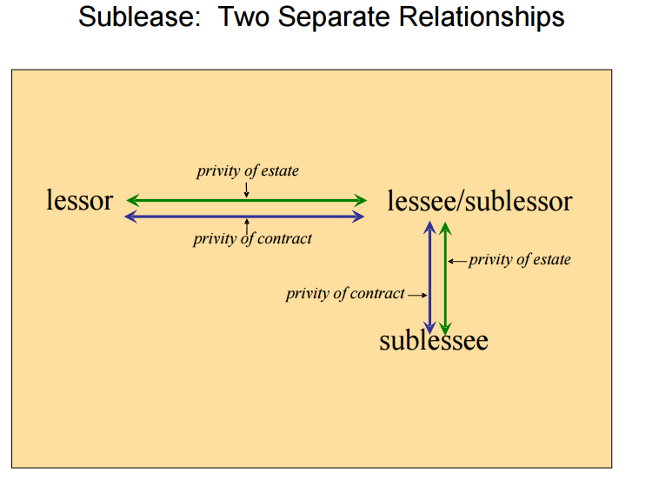

Slide 11
Sublease vs. Assignment
Common Law
Modern Rule
You had to retain a right of re-entry for it to be a sublet (even for one day)
Look at the intent of the parties, Does it look like the transferor is trying to retain a reversion?

Slide 12
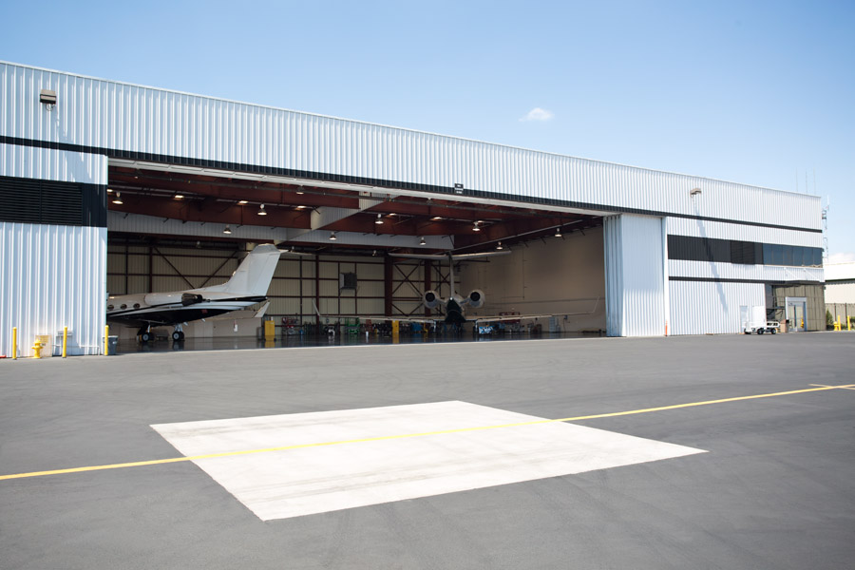

Kendall v. Pestana (Cal. 1985) p. 511

Slide 13
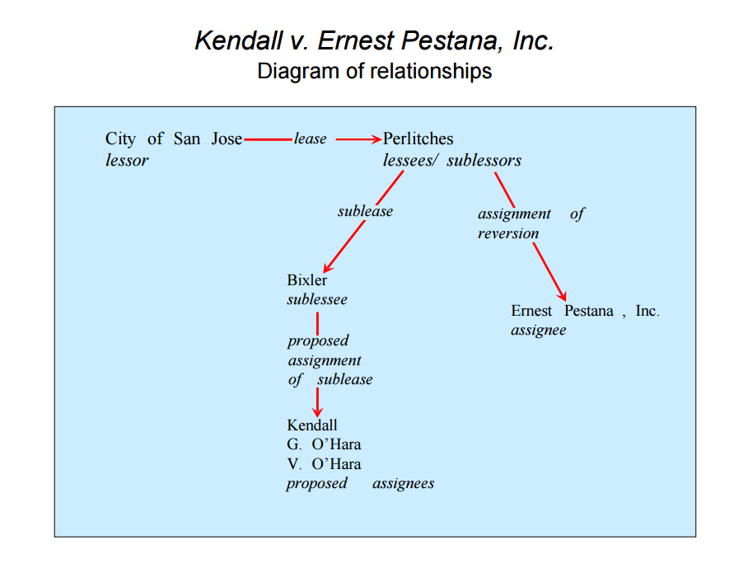

Slide 14
Private Land Use Planning
Chapter 9

Slide 15
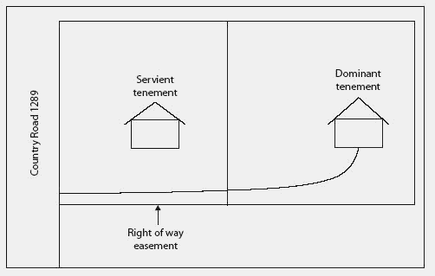
Easements
Non-possessory
Dominant/Servient
Appurtenant / In Gross
Affirmative / Negative

Slide 16
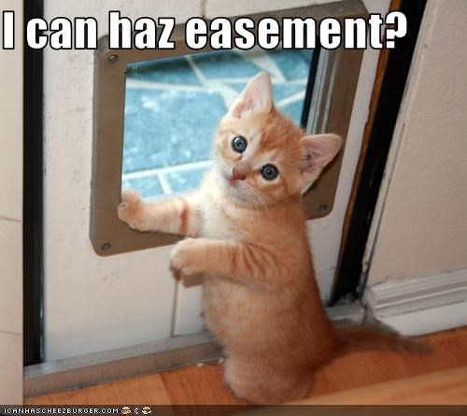
Creation of Easements
Express
Grant
Reservation
Estoppel
Implied
Prior Use
Necessity
Prescription
Condemnation

Slide 17
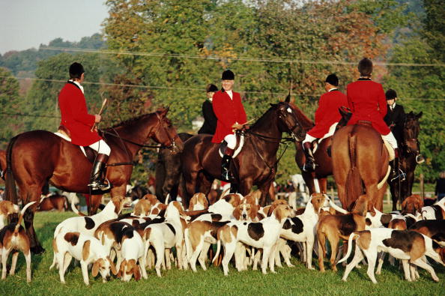
Millbrook Hunt v. Smith
New York 1998
p. 655/669

Slide 18
Easement vs. License?
Paragraph 1: indicates that the Hunt leased a particular one-quarter acre parcel of land for a period of 75 years.
Pursuant to paragraph 6: the Hunt clearly reserved an absolute right to fox hunt on the remaining parcel of land.
Paragraph 10: reserves to the grantor the “absolute right to develop his land” and the right to redirect the Hunt’s trails

Slide 19
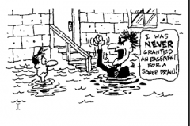
Van Sandt v. Royster
Kansas 1938
p. 658/672

Slide 20
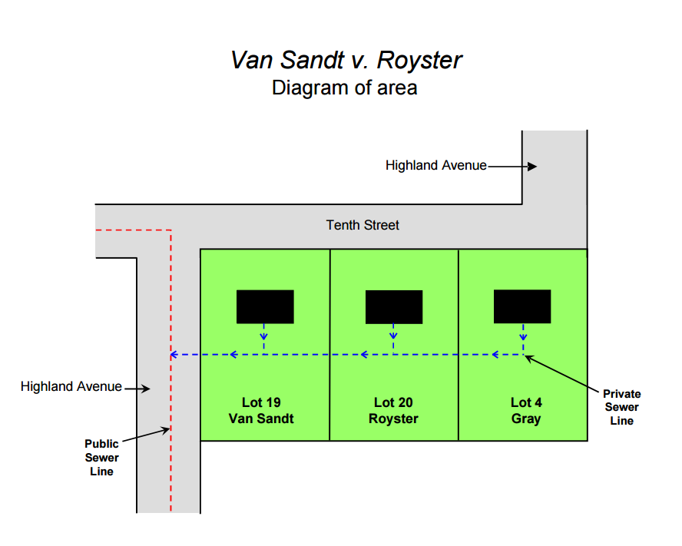

Slide 21
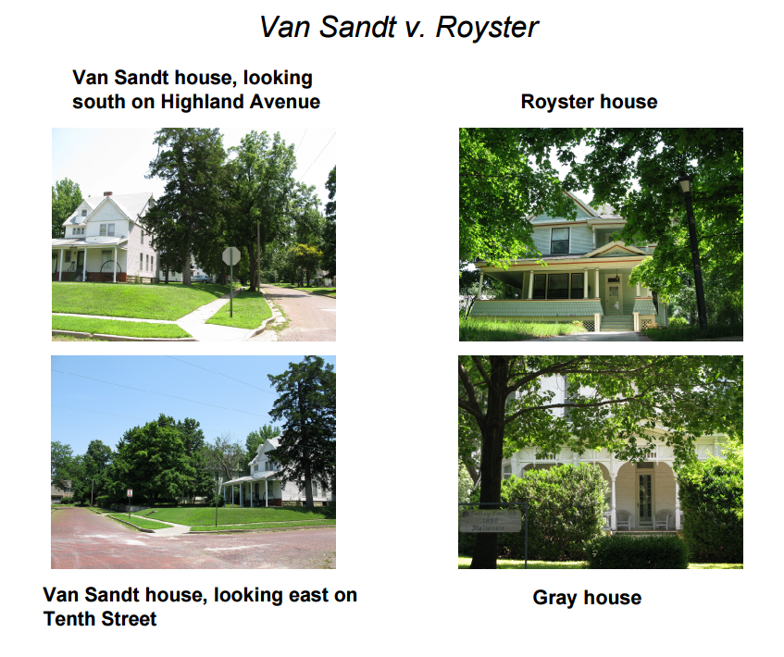

Slide 22
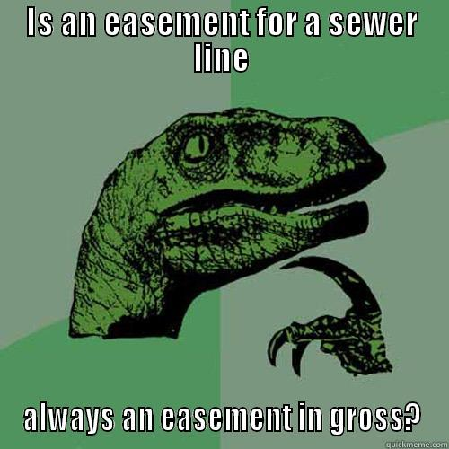
Implied Easements
Prior Use
Necessity

Slide 23
Implied Easement by Prior Existing Use
Severance of title to land held in common ownership
An existing, apparent , and continuous use when the conveyance was made
The use was reasonably necessary

Slide 24

Berge v. State of Vermont
Vermont 2006
p. 665/679

Slide 25
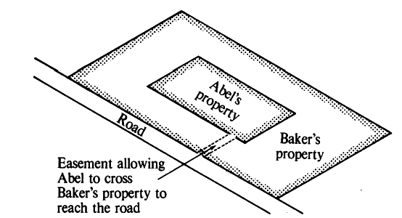
Easements by Necessity
Common Owner
Strict Necessity
Public policy

Slide 26
Termination of Easements
Expiration
Release
Estoppel
Merger
Abandonment
Prescription
Condemnation

Slide 27
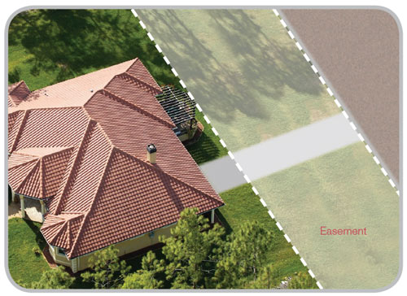
Easement Rules
Transferability
Divisibility
Extent

