Slide 1
Property
Class #9
March 7, 2016

Slide 2

Freehold Estates
Fee Simple Absolute
Life Estate
Fee Tail
Defeasible Fees
Fee Simple Determinable
Fee Simple Subject to a Condition Subsequent
Fee Simple Subject to an Executory Limitation

Slide 3
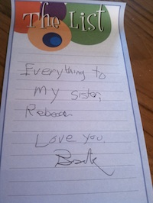
White v. Brown
(Tennessee 1977)
p. 317/323

Slide 4
I, Jessie Lide, being in sound mind declare this to be my last will and testament. I appoint my niece Sandra White Perry to be the executrix of my estate. I wish Evelyn White to have my home and to live in and not to be sold.
I also leave my personal property to Sandra White Perry. My house is not to be sold.

Slide 5
Statutory Presumptions
Against Partial Intestacy
In favor of a grant or devise passing the entire interest of the grantor/testator unless there are clearly contrary words and context

Slide 6
Restraints on Alienation
Valid
Invalid
Partial restrants that are reasonable with respect to duration, scope, and purpose
Disabling: prohibits transfer of interest
Forfeiture: lose your title if you transfer
Promissory: says you have to promise not to transfer

Slide 7
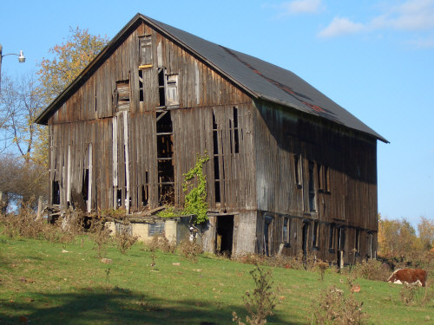
Woodrick v. Wood
(Ohio 1994)
p. 324

Slide 8
George
Catherine
(LE)
Sheridan
(Remainder)
Patricia (Remainder)
Catherine
(Remainder)

Slide 9

Types of Waste
Voluntary Waste
Affirmative Act that significantly reduces property value
Permissive Waste
Failure to take reasonable care to protect the estate
Ameliorative Waste
Affirmative Act that Increases its value

Slide 10
Doctrine of Waste
Common Law (Minority)
Modern View (Majority)
Anything that alters the identity of the premises is waste, regardless of whether the act happened to be beneficial or detrimental to the future interest.
Beneficial use of the property is okay as long as you don’t decrease the property value

Slide 11
Freehold Estates
Fee Simple Absolute
Life Estate
Fee Tail
Defeasible Fees
Fee Simple Determinable
Fee Simple Subject to a Condition Subsequent
Fee Simple Subject to an Executory Limitation

Slide 12
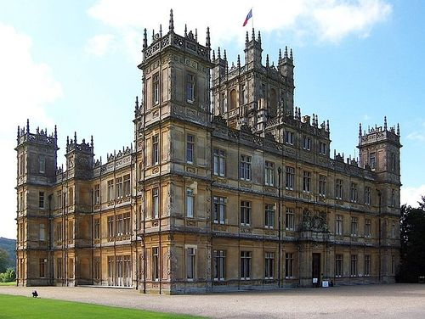
Fee Tail
From O to A and the heirs of her body
A has a fee tail
O has a possibility of reverter (reversionary interest)

Slide 13
Modern Fee Tail Options
Allowed in DE, ME, MA, & RI
Convert to a LE in the first person and FSA in the next person
Treat as a FSA
From O to A and the heirs of her body.
A gets in Fee Tail. Future interest in O (reversion if A’s line dies out).
A gets a LE. After her death, her heirs get in FSA
A gets FSA.

Slide 14
Freehold Estates
Fee Simple Absolute
Life Estate
Fee Tail
Defeasible Fees
Fee Simple Determinable
Fee Simple Subject to a Condition Subsequent
Fee Simple Subject to an Executory Limitation

Slide 15
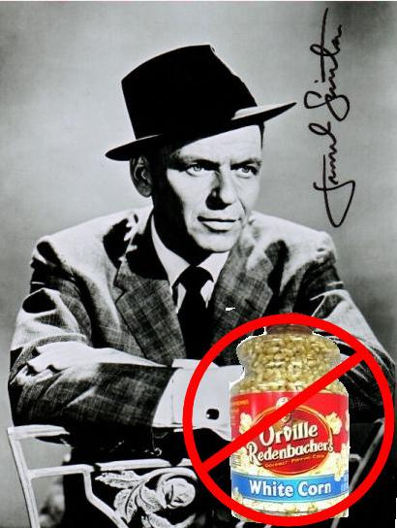
Fee Simple Determinable
From O to A and her heirs so long as Balckacre is used for agriculture
A has a fee simple determinable (FSD)
O has a possibility of reverter (POR)
Frank Sinatra Doesn’t Prefer Orville Redenacher

Slide 16

Magic Words
Fee Simple Determinable
Fee Simple Condition Subsequent
Words of Purchase
Words of Limitation
Words of Duration
So Long As
While
Until
During
Words of Purchase
Words of Limitation
Words of Condition
Provided that
But if
On the condition that

Slide 17
Fee Simple Determinable Example
O to G and her heirs until Alaska secedes from the United States
Words of limitation?
And her heirs = FSA
Words of duration?
Until
What does O have?

Slide 18
FSD
Common Law
Modern Rule
Not devisable
Not assignable
Only descendible
Alienable, devisable, and descendible

Slide 19
Fee Simple Subject to a Condition Subsequent
Fee simple estate created in a transferee
May be terminated at the election of the transferor when a certain condition or event occurs
It does not end automatically. Transferor has the power to end it.
Right of Re-entry or Power of Termination
Self-help or quiet title action

Slide 20
Magic Words
Fee Simple Determinable
Fee Simple Condition Subsequent
Words of Purchase
Words of Limitation
Words of Duration
So Long As
While
Until
During
Words of Purchase
Words of Limitation
Words of Condition
Provided that
But if
On the condition that

Slide 21
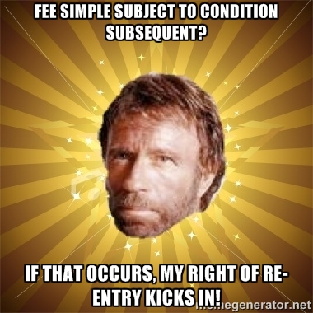
Fee Simple Subject to a Condition Subsequent
From O to A and her heirs, provided that if Blackacre is not used for agriculture, O may re-enter and take possession
A has a FS subject to a condition subsequent
The condition subsequent = land no longer used for agriculture
O has a right of re-entry / power of termination
If O exercises the right, O has a FSA
If O doesn’t?

Slide 22

Fee Simple Subject to an Executory Limitation
From O to A and her heirs so long as Blackacre is used for agriculture, and it if is not so used to B and her heirs
A has Fee Simple Subject to an Executory Limitation
B has an Executory Interest
O has Nothing

Slide 23

Mahrenholz v. County Board of School Trustees of Lawrence County
The deed provided that “this land to be used for school purposes only; otherwise to revert to Grantors herein.”

Slide 24
Mahrenholz’ Claim
1941: Huttons to School District
1941-1959: Huttons convey to Jacqmains (including future interest retained by the Huttons)
1959: Jacqmains sell to Mahrenholz
Huttons died intestate
1969: Harry inherits
May 1977: Harry transfers his interest to Mahrenholz
September 1977: Harry disclaimed and released his interest in the property in favor of the school district

Slide 25
EXAMPLE
From O to A so long as he uses it exclusively for organic farming, otherwise to revert to me; but if A should fail to use Blackacre for organic farming, or ever apply pesticides or chemical fertilizers to the soil, I retain the right to enter and reclaim possession and ownership of Blackacre.

Slide 26
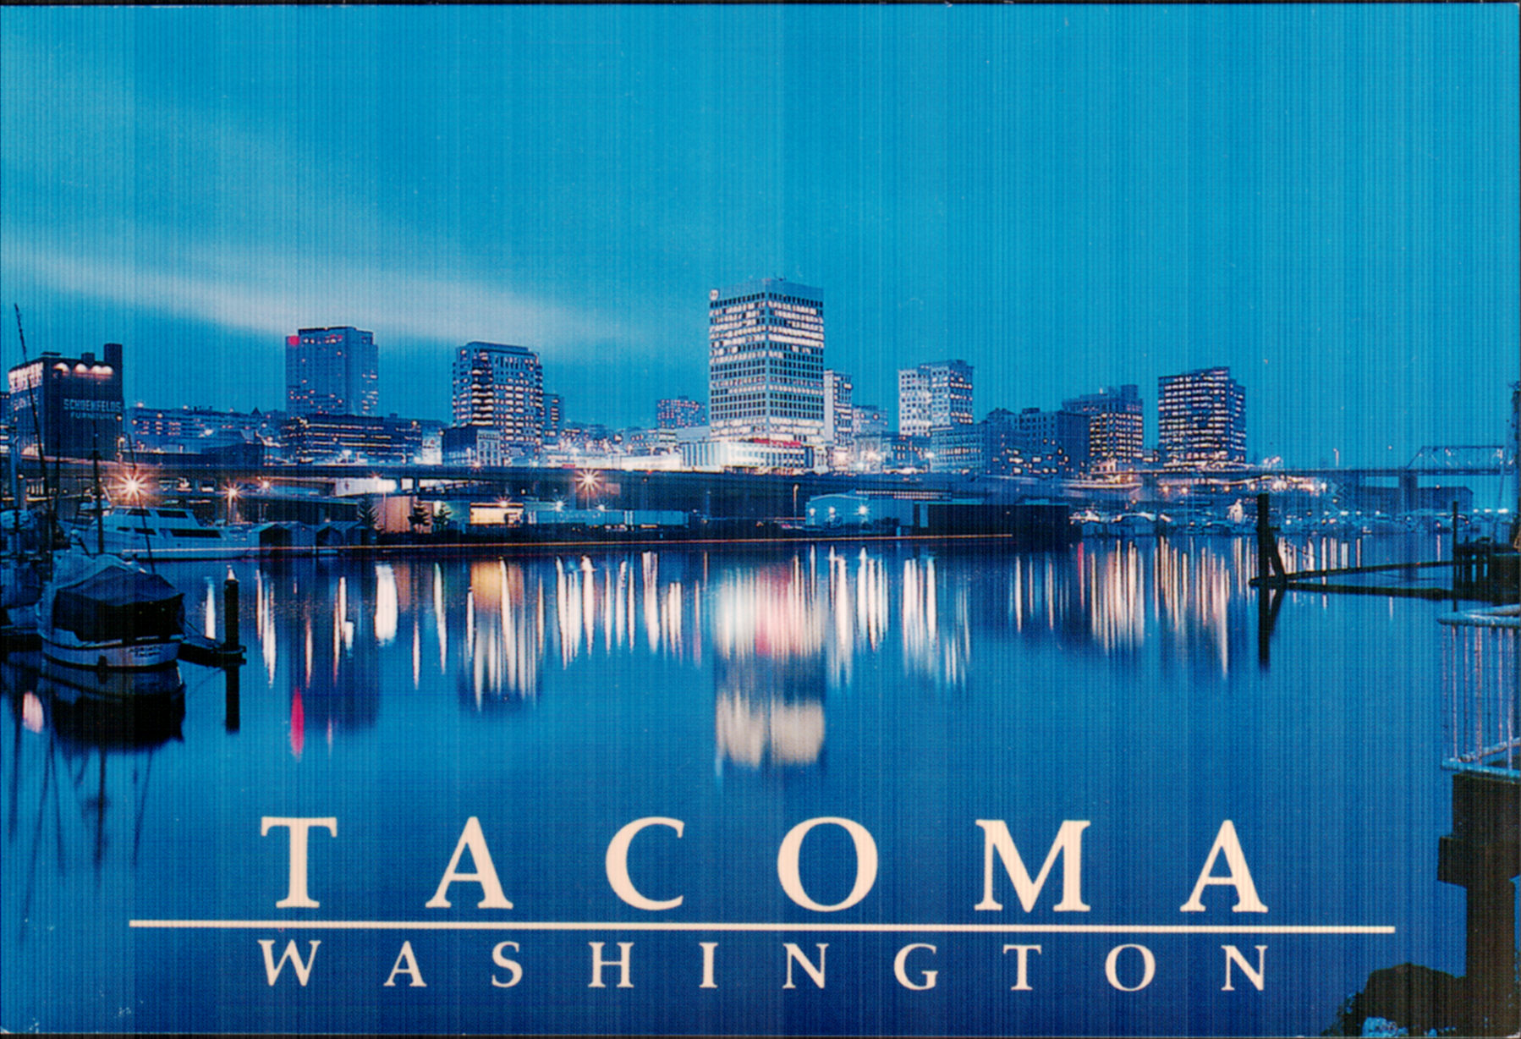
Metropolitan Park District v. Unknown Heirs of Rigney ( Washington 1965)

