Slide 1
Property
Class #8
March 2, 2016

Slide 2
Survey Feedback
Number of Hours Spent Outside of Class: 1-22 (average was 6)
Too much reading. Too many Cases.
Easier book than any other class straightforward material.
Interactive Features? What’s that? “don’t know how”
Most confusing? Hostility and Found Property
Average time spent in office hours?

Slide 3
Selected Quotes
Wish we had the slides in advance.
More hypos!
Give us the Rules! Summarize cases.
Assignment #1 was too vague. Set a time limit for questions.
“Memes are the death of creativity”
I don’t like the British cases.
“I am upset you sold your mug. I woulda gotten you more $.”
“I assumed property would be uninteresting.”

Slide 4

GIFTS

Slide 5
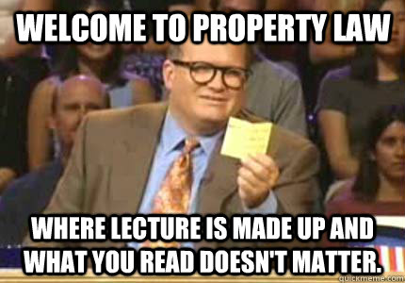
Gift Giving
Donative Intent
Delivery
Acceptance

Slide 6

Delivery
Actual
Constructive
Symbolic

Slide 7
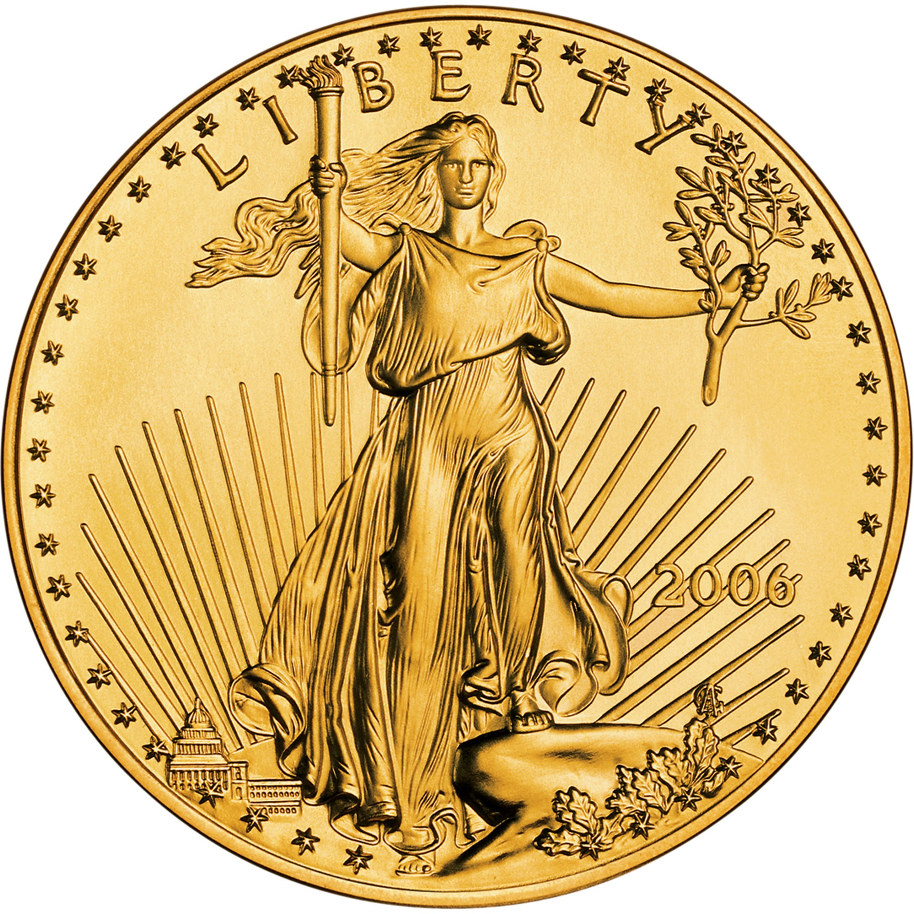
Gold Coin Example
Father leaves a gold coin on his minor daughter’s desk in her room. Gift?
Suppose he does it every year on her birthday. Gift?
Suppose father visits his adult daughter in her own home, a coin slips out of his pocket. Daughter calls next day to say she found his coin. He says “Keep It.” Gift?

Slide 8

Types of Gifts
Inter Vivos
Causa Mortis
Testamentary

Slide 9

Gruen v. Gruen
New York 1986
p. 209/213

Slide 10
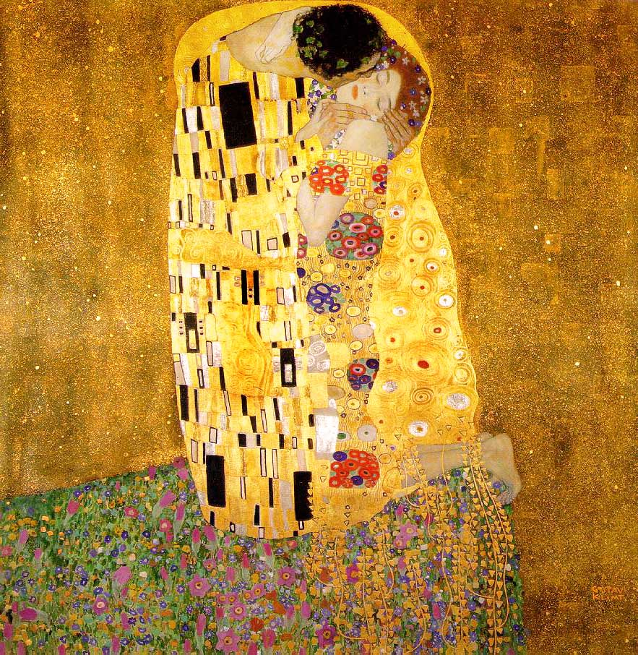
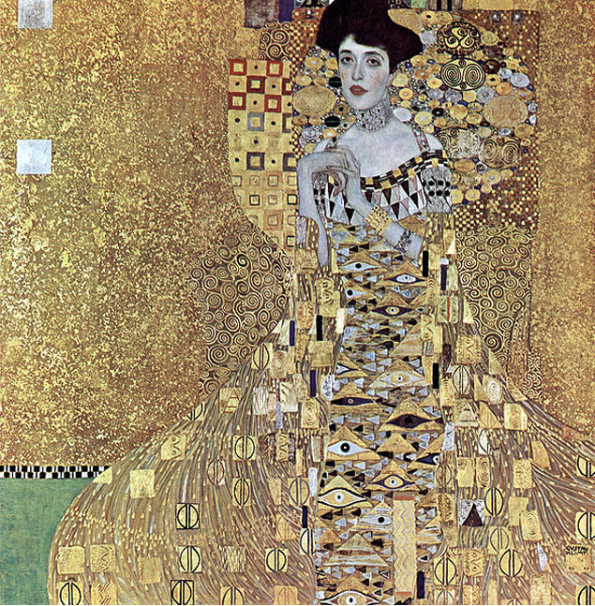

Slide 11
Gift Giving
Donative Intent
Delivery
Acceptance

Slide 12
Gruen Case: Donative Intent
What was the gift here?
Present Ownership of the Painting?
Future Interest?
Present ownership of a future interest (a nonpossessory property right)
“As long as the evidence establishes an intent to make a present and irrevocable transfer of title or the right of ownership, there is a present transfer of some interest and the gift is effective immediately.”

Slide 13
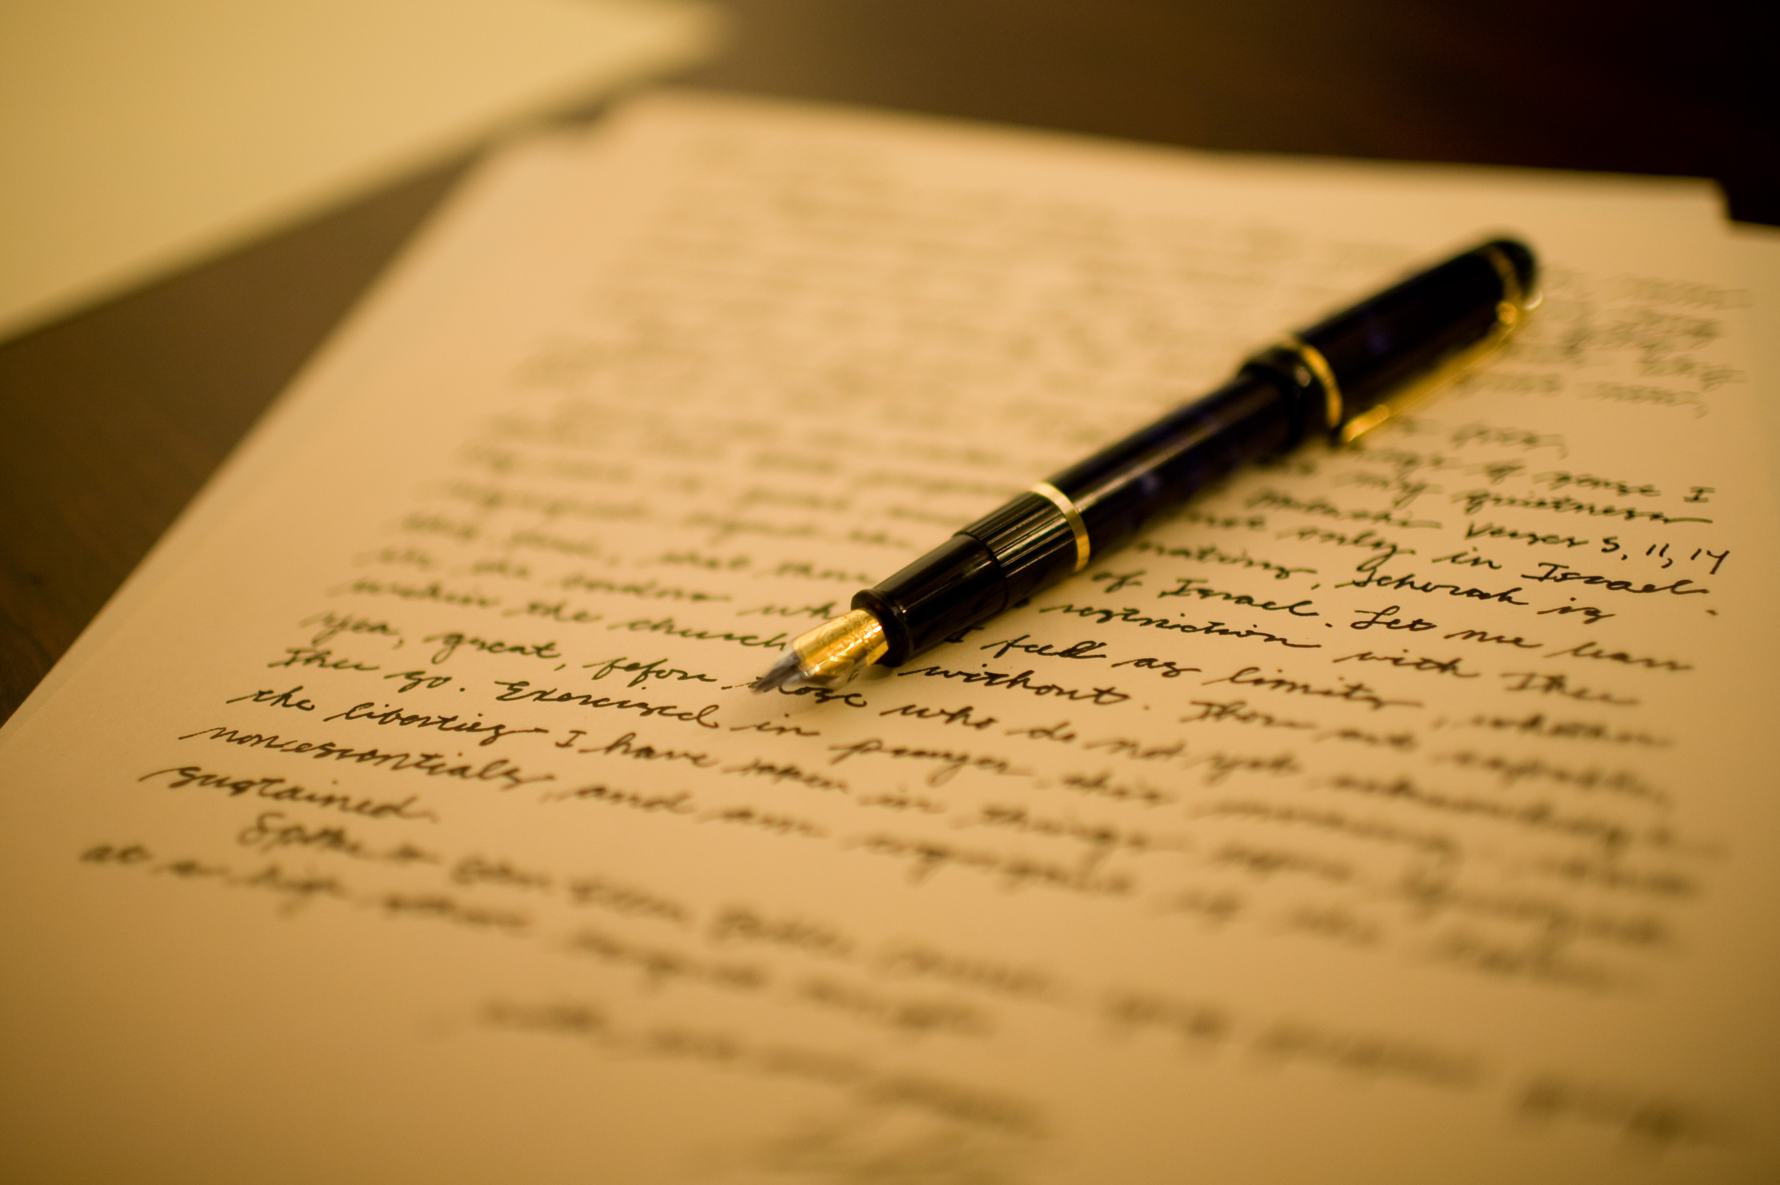
Gruen Case: Delivery
Acceptable Types of Delivery?
Actual
Constructive
Symbolic

Slide 14
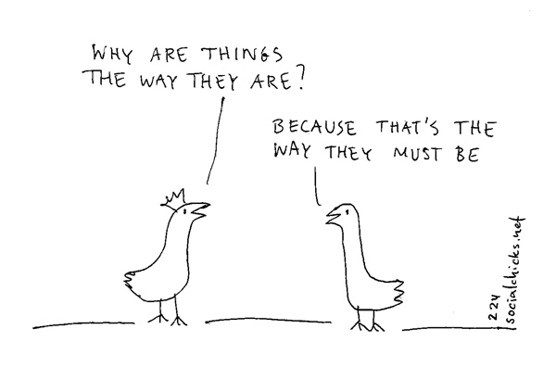
Gruen Case: Acceptance
Where do our presumptions lie?
Evidence Supporting Acceptance?
Presume Acceptance
Held on to the letters
Told people about the painting
BUT: divorce proceedings?

Slide 15
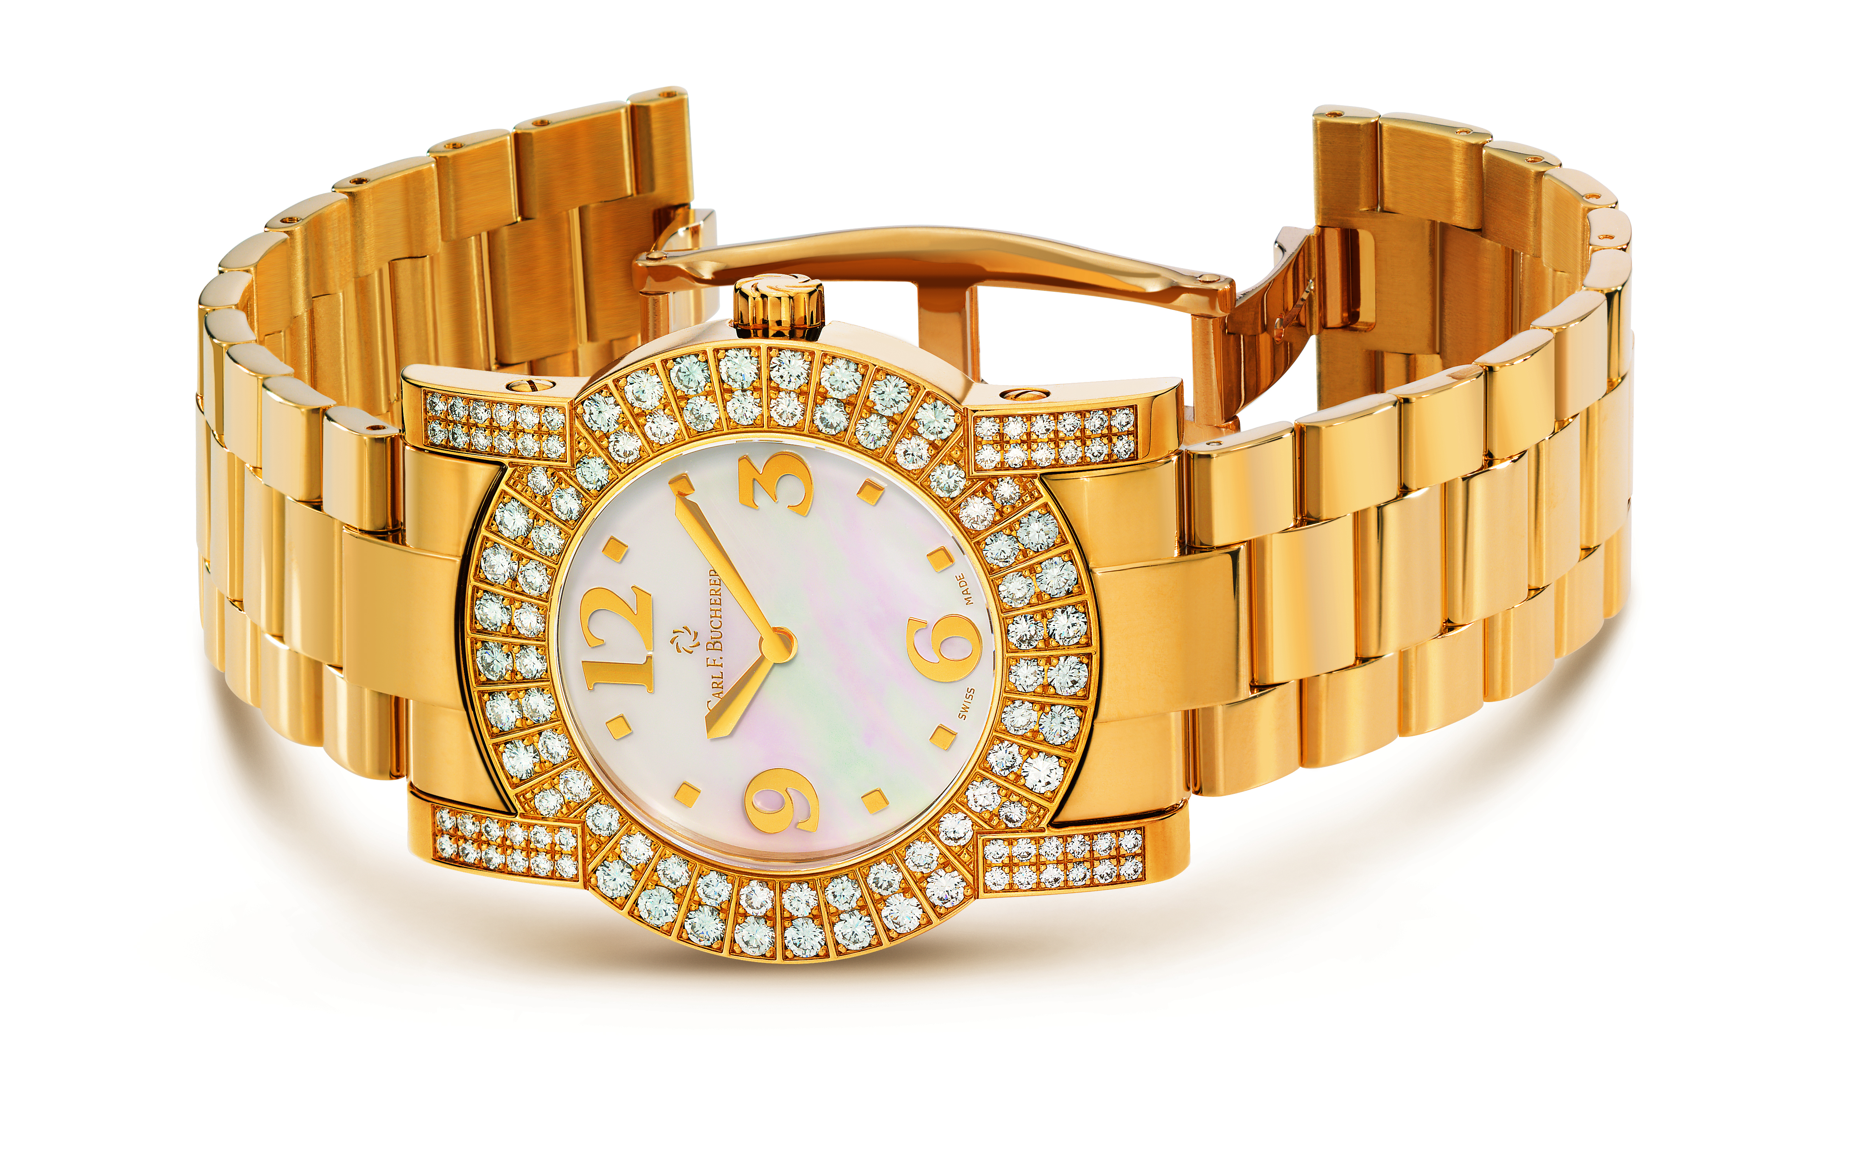
Gold Watch Example
Daughter admires mom’s gold watch. Mom says “It’s yours when I die.” Gift?
Mom hand her the watch and says “here it is yours but I want to hold onto it until I die.” Gift?

Slide 16

Two Additional rules for Delivery
Delivery is not necessary when the property is already in the possession of the donee;
The donor may make a valid gift inter vivos to the donee by way of a third party or the donor’s agent.

Slide 17
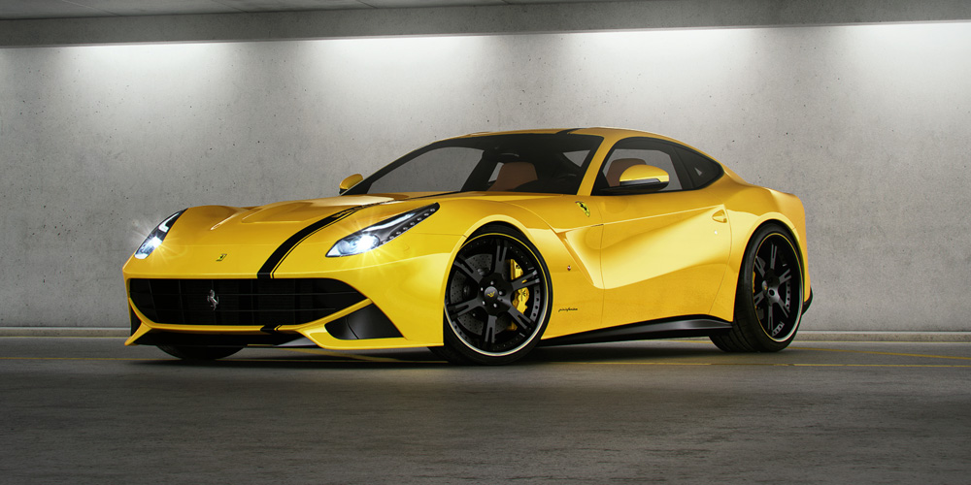
Ferrari Example
Sean and Heather are besties. Sean borrowed Heather’s Ferrari last month and still has it in her garage. Sean wins the lottery and when he calls Heather to tell her of his good fortune, he says “You can keep the Ferrari.” Gift?

Slide 18
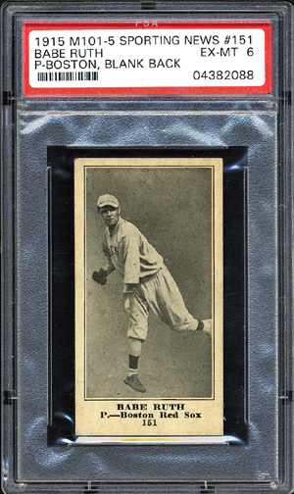
Tyleana calls Martha over to her locker and shows Martha her Babe Ruth Rookie Card. Tyleana tells Martha, “I want you to give this card to Andy.” Martha takes the card, tracks Andy down, and hands it to him. Gift?

Slide 19
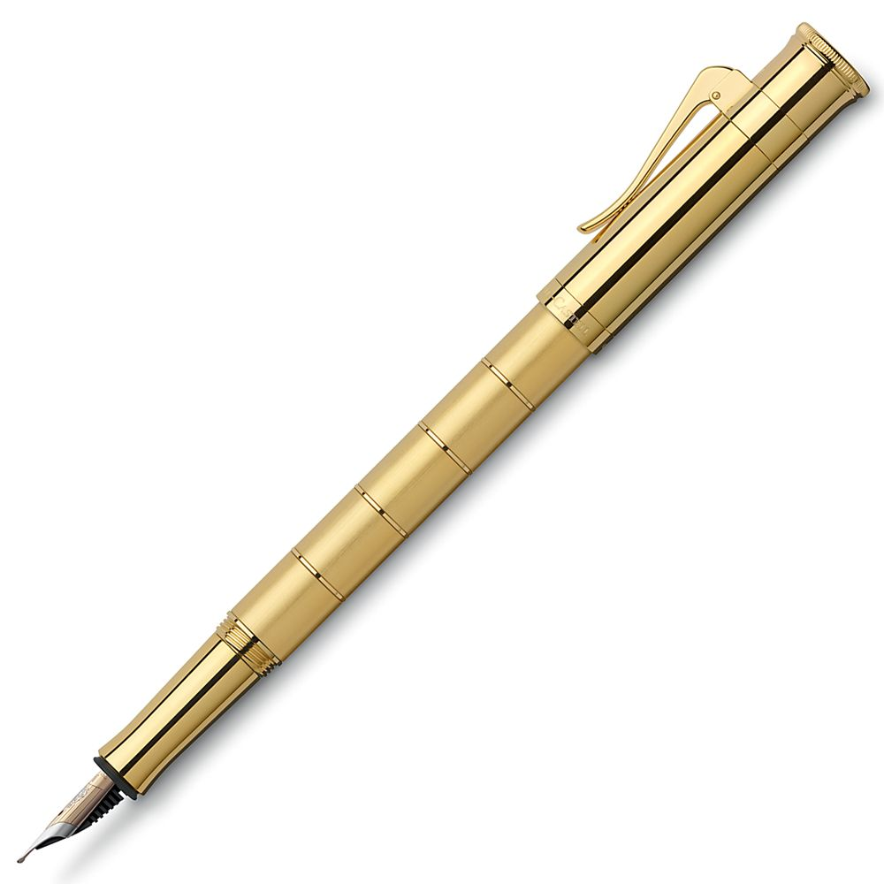
Gift?
Andy calls his brother into his room. He points at a gold pen on his desk and declares, “I give you this pen.”

Slide 20
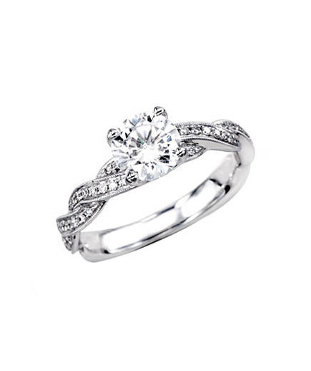


Slide 21
Albinger v. Harris
Montana 2002
p. 219/223

Slide 22

Take the car, the horse, the dog, and the ring and get the hell out.

Slide 23
Gift Giving
Donative Intent
Delivery
Acceptance

Slide 24

Albinger Case: Gender Bias?
If this Court were to fashion a special exception for engagement ring actions under gift law theories, we would perpetuate the gender bias attendant upon the Legislature’s decision to remove from our courts all actions for breach of antenuptial promises”

Slide 25
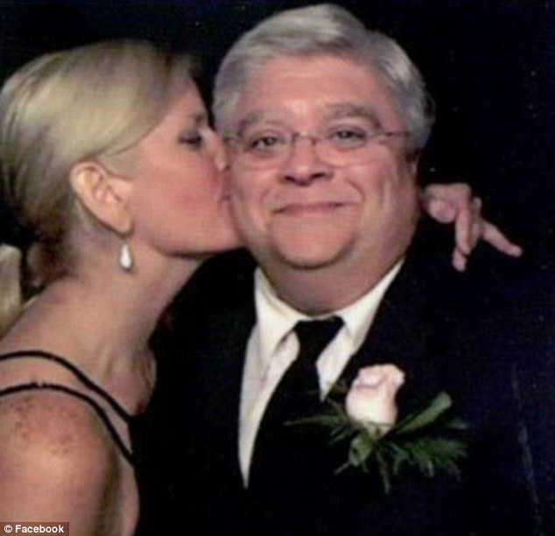
Local News
Clark, 38, said a text message from him breaking off their engagement called the ring “a $50,000 parting gift.”

Slide 26
New York Law
Engagement ring is in the nature of a pledge for contract of marriage, and where no impediment exists to marriage, if the recipient breaks the engagement she is required, upon demand, to return the ring on the theory that it constituted a conditional gift.
Lowe v. Quinn, 1971, 27 N.Y.2d 397, 318 N.Y.S.2d 467, 267 N.E.2d 251.

Slide 27
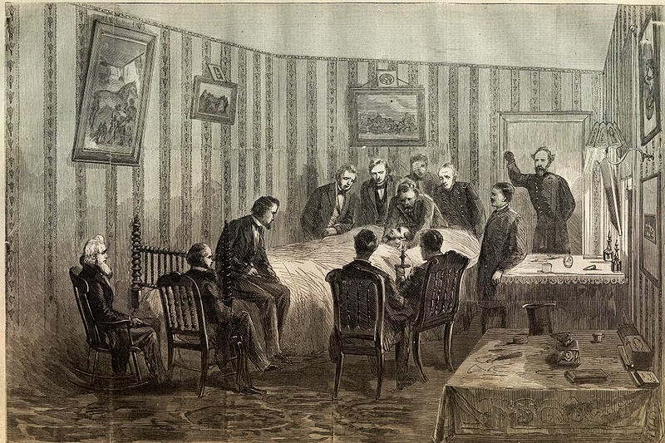
Brind v. International Trust
Colorado 1919 P. 226

Slide 28
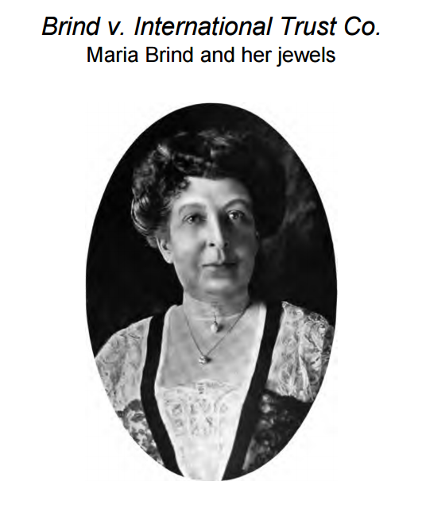

Slide 29

Gifts Causa Mortis
Must be given while the person is alive
Must be given in anticipation of death
You get it back if you don’t die
(but what if you don’t die from what you thought would kill you?)

Slide 30
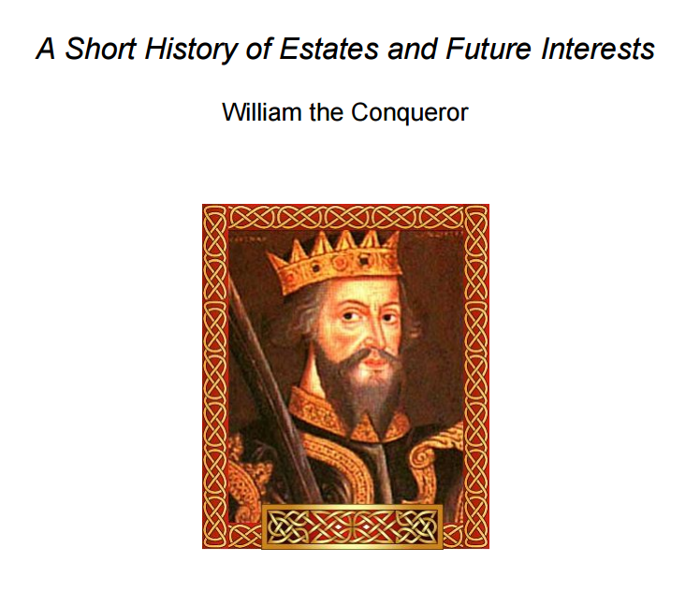

Slide 31

Estates in Land

Slide 32
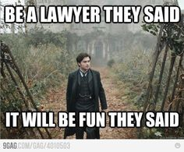
Vocabulary and Concepts
Estates in Land
Present Possessory Estates
Non-possessory Estates
Future Interests
Freehold vs. Non-Freehold

Slide 33
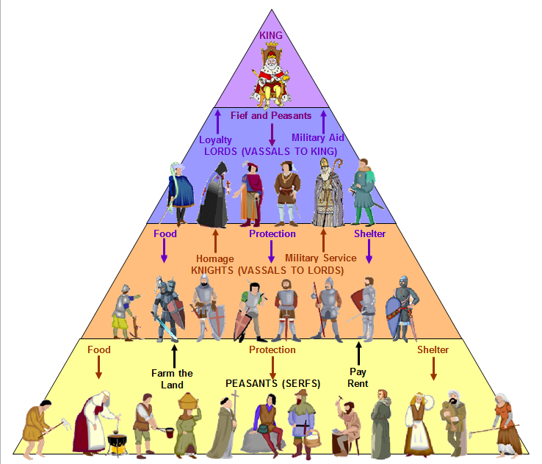
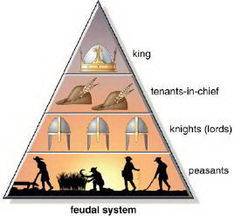
History!

Slide 34
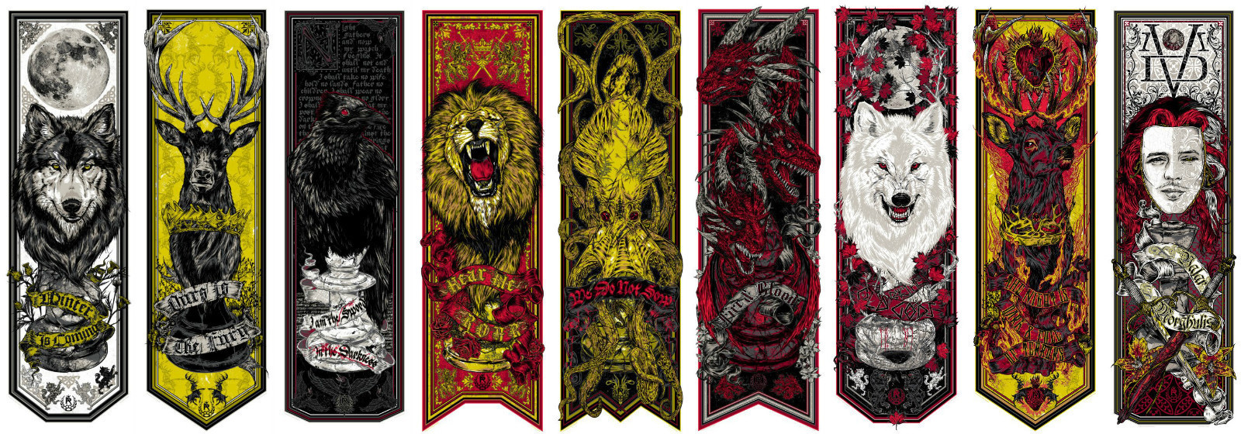
Call the Banners!

Slide 35
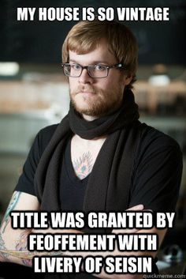
Magna Carta (1215)
Statute Quia Emptores (1290)
Feoffment with livery of Seisin
Statute of Frauds (1677)

Slide 36

Freehold Estates
Fee Simple Absolute
Life Estate
Fee Tail
Defeasible Fees
Fee Simple Determinable
Fee Simple Subject to a Condition Subsequent
Fee Simple Subject to an Executory Limitation

Slide 37
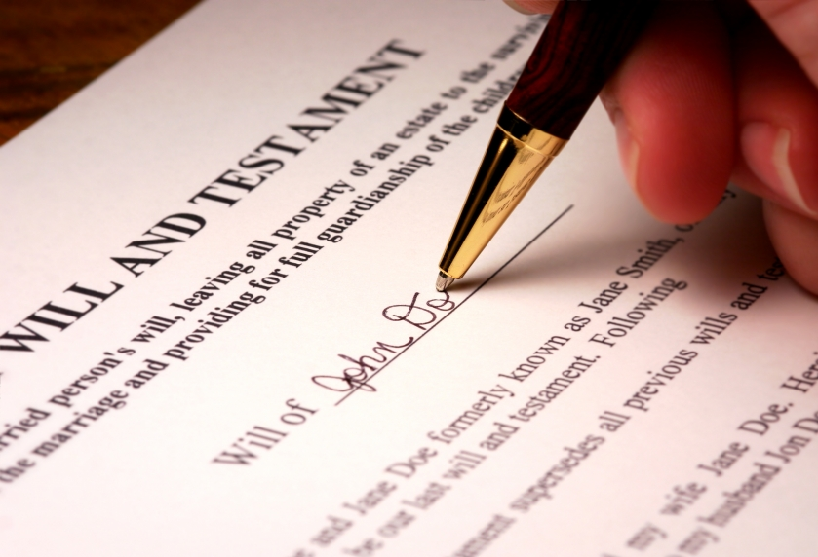
Transfer Methods
Deed
Conveyance / Grant
Grantor/Grantee
Will
Devise
Testator (Testatrix)/Devisee
Intestate Succession
Descends
Heirs

Slide 38
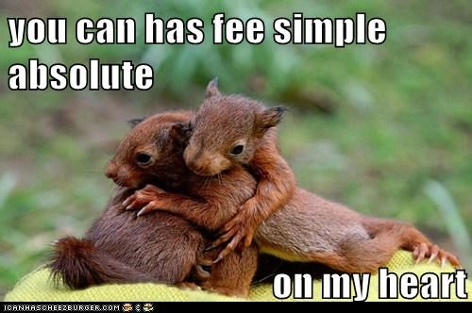
Fee Simple Absolute
From O to A and her heirs
From O to A
From O to A forever and ever
A has a fee simple absolute
O has nothing
A’s heirs?

Slide 39
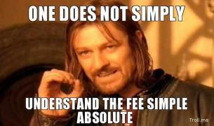
Fee Simple Absolute Structure
Words of Purchase
Identify the Grantee
“To A”
Words of Limitation
Identify the Type of Estate
“And his heirs”

Slide 40
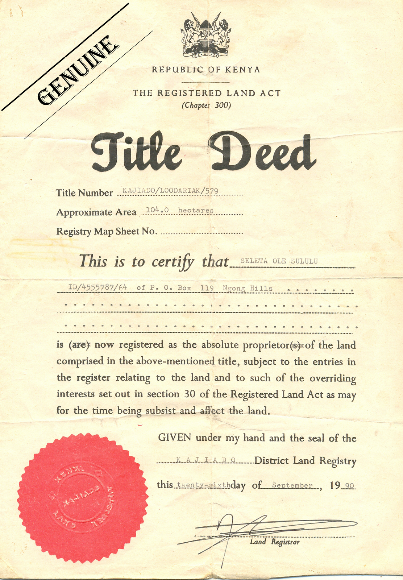
Cole v. Steinlauf
Connecticut 1957
p. 312 / 318

Slide 41
Cole
The contract provided that if Steinlauf was unable to convey title to the premises free and clear of any defect of title, the plaintiffs could reject the deed and recover their deposit and title search fee.

Slide 42
1945
Defendant’s Predecessor
19??
Defendant (Steinlauf)
1955
Plaintiff (Cole)

Slide 43
Cole Case:
Common Law Rule
Modern Rule
“[t]o create an estate of inheritance [that is, fee simple] in land by deed, it is necessary to use the word “heirs”
The magic word of “heirs” need not be used.

Slide 44

nemo dat quod non habet

Slide 45
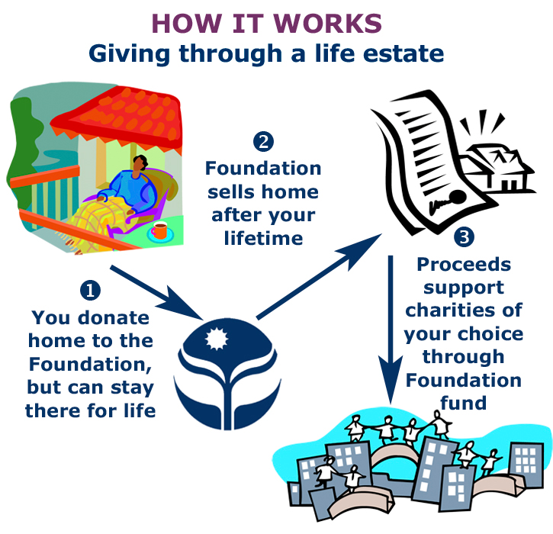
Life Estate
From O to A for life.
A has a life estate
O has a reversionary interest
If O dies before A?
From O to A until she dies then to B.
A has a life estate
B has a remainder
O has nothing

Slide 46
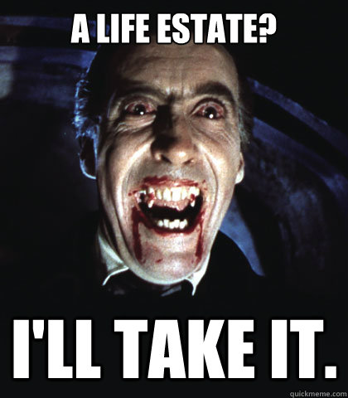
Life Estate Structure
Words of Purchase
Identify the Grantee
“To A”
Words of Limitation
Identify the Type of Estate
“for life”

Slide 47
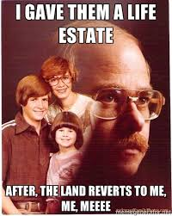

Two Types of Life Estates
Life Estate
Life Estate Pur Autre Vie

Slide 48
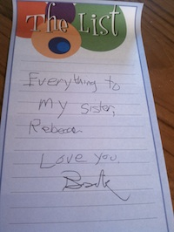
White v. Brown
(Tennessee 1977)
p. 317/323

Slide 49
I, Jessie Lide, being in sound mind declare this to be my last will and testament. I appoint my niece Sandra White Perry to be the executrix of my estate. I wish Evelyn White to have my home and to live in and not to be sold.
I also leave my personal property to Sandra White Perry. My house is not to be sold.

