Slide 1
Property
Class #13
March 28, 2016

Slide 2
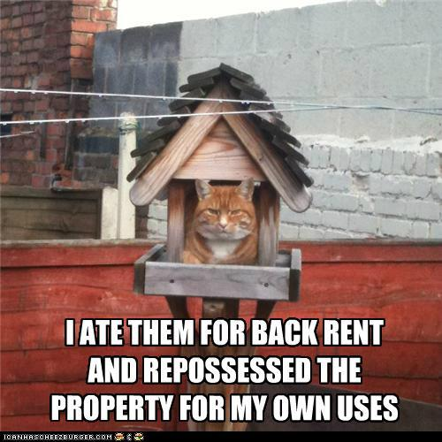
Constructive Eviction Procedure
Must Notify LL of problem
Give LL a reasonable period to fix the problem
Vacate the Premises

Slide 3
Constructive Eviction Problem
Donell enters into a ten-year term of years tenancy in Zach’s commercial office building in a southwestern state, where he plans to open an accounting firm. The lease states that “LL will provide air conditioning,” but it says nothing about the required temperature. When Donell takes occupancy, he learns that Zach’s building policy is to ensure that the office temperature never exceeds 78 degrees. Zach explains that this is an energy conservation measure. As a result, Donell’s employees are frequently hot, sweaty, and short-tempered; an expert consultant finds that their productivity is 4% lower than it would be at 72. Zach refuses to change the policy

Slide 4
Wade v. Jobe
Utah 1991
P .473/491

Slide 5
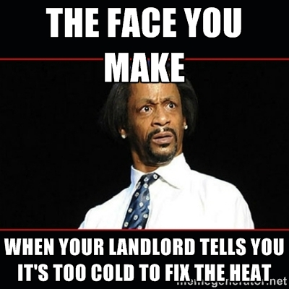
Implied Warranty of Habitability
“We reject the rule of caveat emptor and recognize the common law implied warranty of habitability in residential leases.”

Slide 6

Procedure
Premises unfit for human occupation
LL gets a reasonable time to repair
LL not liable for defects caused by T

Slide 7

Remedies for Breach
Withhold Rent (all of it?)
Repair and deduct
Sue for Damages

Slide 8
Breach of the Warranty of Habitability?
Due to a city-wide strike, no one picked up the garbage at the apartment building where Kayla lives for four weeks. This attracted cockroaches and other vermin to the building where they infested Kayla’s apartment.
Sam’s unit is on the 5th floor. Someone on the 4th floor regularly smokes inside his apartment. Sam smells this smoke every day because it travels up through the ventilation shaft. It is quite strong on weekends but barely noticeable the rest of the time.

Slide 9
Breach of the Warranty of Habitability?
The dishwasher inside Allie’s rented house is broken. Her LL tried to fix it on 3 occasions but is unable to do so because the needed part is no longer sold.
The painted walls inside Jordan’s duplex unit are cracked and scratched and some of the lead paint is falling off.

Slide 10
Ending the Tenancy

Slide 11

Surrender

Slide 12
Abandonment (from the Restatement)
An abandonment of the leased property by the tenant occurs when he vacates the leased property without justification and without any present intention of returning and he defaults in the payment of the rent.

Slide 13

Sommer v. Kridel
New Jersey 1977
p. 501

Slide 14
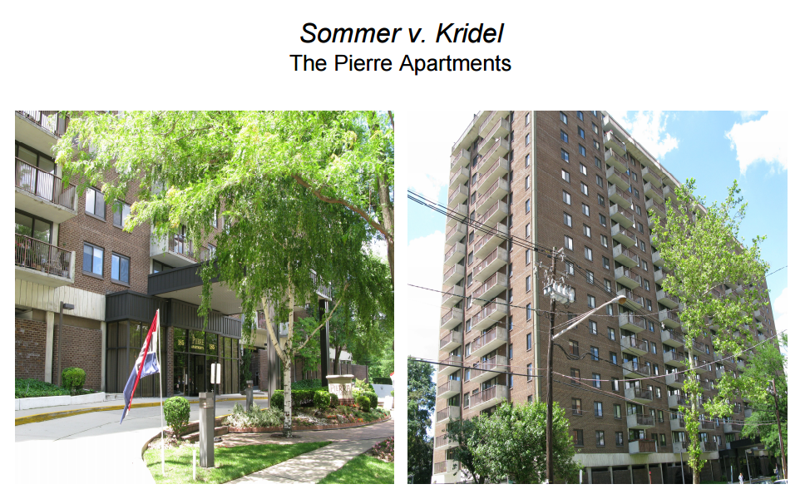

Slide 15
Surrender

Slide 16
Kridel’s Letter
…. In view of the above, I cannot take possession of the apartment and am surrendering all rights to it. Never having received a key, I cannot return the same to you.
I beg your understanding and compassion in releasing me from the lease, and will of course, in consideration thereof, forfeit the 2 month’s rent already paid.
Please notify me at your earliest convenience.

Slide 17

Abandonment

Slide 18
Abandonment of the leased property by T occurs when he vacates the leased property w/o justification and w/o any present intention of returning and he defaults in payment of the rent
Traditional LL Options
Sue for all the rent
Terminate the Lease
Mitigate Damages and then sue for remaining rent

Slide 19
Christian enters into a 2-year lease with Ian for a studio apartment in Christian’s 20-unit complex, agreeing to pay rent of $1,000/month. One year later Ian abandons the apartment.
Christian places an ad in the local newspaper to rent vacant studio apartments. When Peter visits in response to the ad, Christian first shows Peter the other vacant studios, leaving Ian’sfor last. Is that okay?
Christian puts a sign in the window of Ian’s unit. The sign is 2 feet tall and 3 feet wide and it reads “For rent. Call 851-7896.” No one comes to look at the unit.
Christian hires a real estate broker to find tenants for all of his vacant apartments. The broker finds Ben who wants to rent Ian’s apartment, offering to pay $900/month. Christian refuses.

Slide 20
Hillview Associates v. Bloomquist
Iowa 1989
p. 510/528

Slide 21
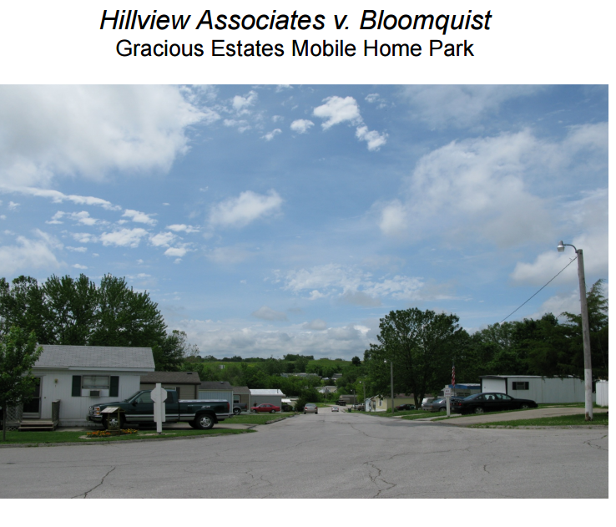

Slide 22
1. Except as provided in this section, a landlord shall not retaliate by increasing rent or decreasing services or by bringing or threatening to bring an action for possession or by failing to renew a rental agreement after any of the following:
(a) The tenant has complained to a governmental agency charged with responsibility for enforcement of a building or housing code of a violation applicable to the mobile home park materially affecting health and safety….
(b) The tenant has complained to the landlord of a violation under section 562B.16 [which requires the landlord to maintain the park in habitable condition].
(c) The tenant has organized or become a member of a tenant’s union or similar organization….

Slide 23
Iowa Code § 562B.32 (1987)
2. If the landlord acts in violation of subsection 1 of this section, the tenant…has a defense in an action for possession. In an action by or against the tenant, evidence of a complaint within six months prior to the alleged act of retaliation creates a presumption that the landlord’s conduct was in retaliation….For the purpose of this subsection, “presumption” means that the trier of fact must find the existence of the fact presumed unless and until evidence is introduced which would support a finding of its nonexistence.
3. Notwithstanding subsections 1 and 2 of this section, a landlord may bring an action for possession if either of the following occurs:
(a) The violation of the applicable building or housing code was caused primarily by lack of reasonable care by the tenant or other person in the household or upon the premises with the tenant’s consent.
(b) The tenant is in default of rent three days after rent is due….

Slide 24
Berg v. Wiley
Minnesota 1978
p. 520/534

Slide 25
