Slide 1
Property
Class #6
2/24/16

Slide 2

Categories Found Chattels
Lost
Mislaid
Abandoned
Treasure Trove

Slide 3
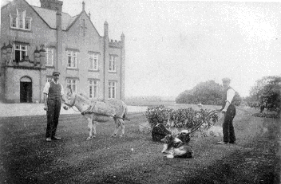
Hannah v. Peel
England 1945
p. 175/178

Slide 4
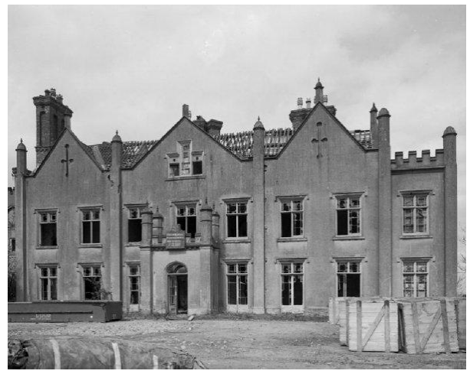

Slide 5
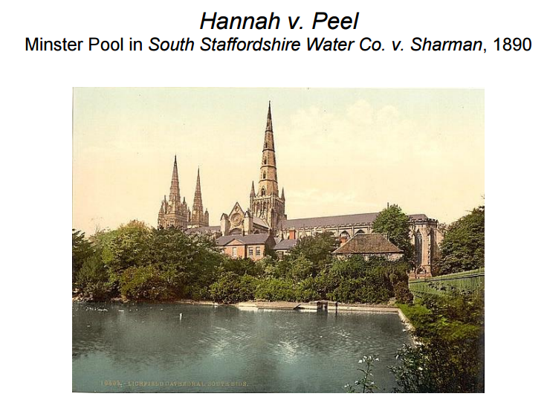

Slide 6

Lost?
Mislaid?
Abandoned?

Slide 7

Lost or Mislaid?
Jaela owns a home. She hires Amanda to do some repairs on her house. While Amanda is working, she find a hidden cache of money beneath the floor. Who owns the money?

Slide 8
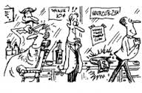
McAvoy v. Medina
Massachusetts 1866
P. 183/186

Slide 9
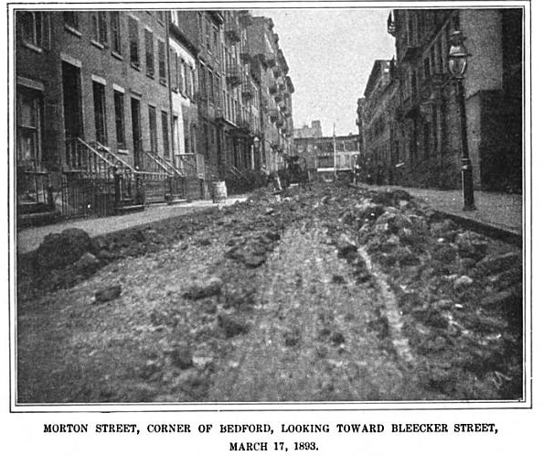
Haslem v. Lockwood
Connecticut 1871
p. 185/188

Slide 10
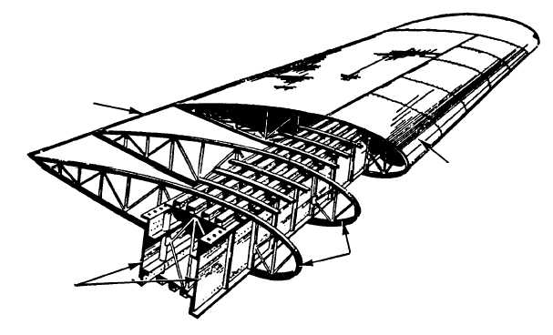
Benjamin v. Lidner Aviation
Iowa 1995
p. 188/191

Slide 11
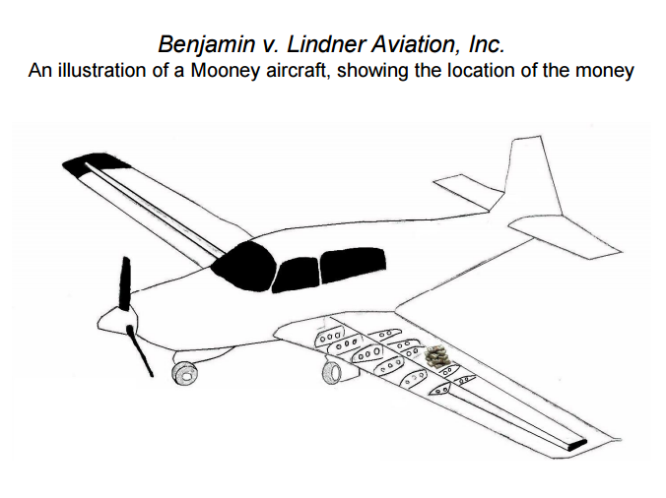

Slide 12
Examples from p. 197
Nate F. buys a safe at an auction and asks Kristian to sell it at a weekend garage sale. While Kristian is showing the safe, he finds a wad of cash stuffed between the inner lining and the outer metal wall.
Jairo, a contractor, agrees to demolish Tabitha’s building and to remove all resulting debris. After demolition, while Jairo is moving debris into a dump truck, he discovers valuable bearer bonds inside part of an old wall.

Slide 13
More Examples
Farmer Emma employs two neighborhood boys to clean her barn. Underneath the chicken coop, the kids discover an old, rusted can filled with silver dollars.
Shazia rents an apartment from Rosa. Shazia finds a sack filled with uncut diamonds wedged underneath the bottom shelf in one closet.

Slide 14
New York Law
3. The term "lost property" as used in this article includes lost or mislaid property. Abandoned property, waifs and treasure trove, and other property which is found, shall be presumed to be lost property and such presumption shall be conclusive unless it is established in an action or proceeding commenced within six months after the date of the finding that the property is not lost property.

Slide 15
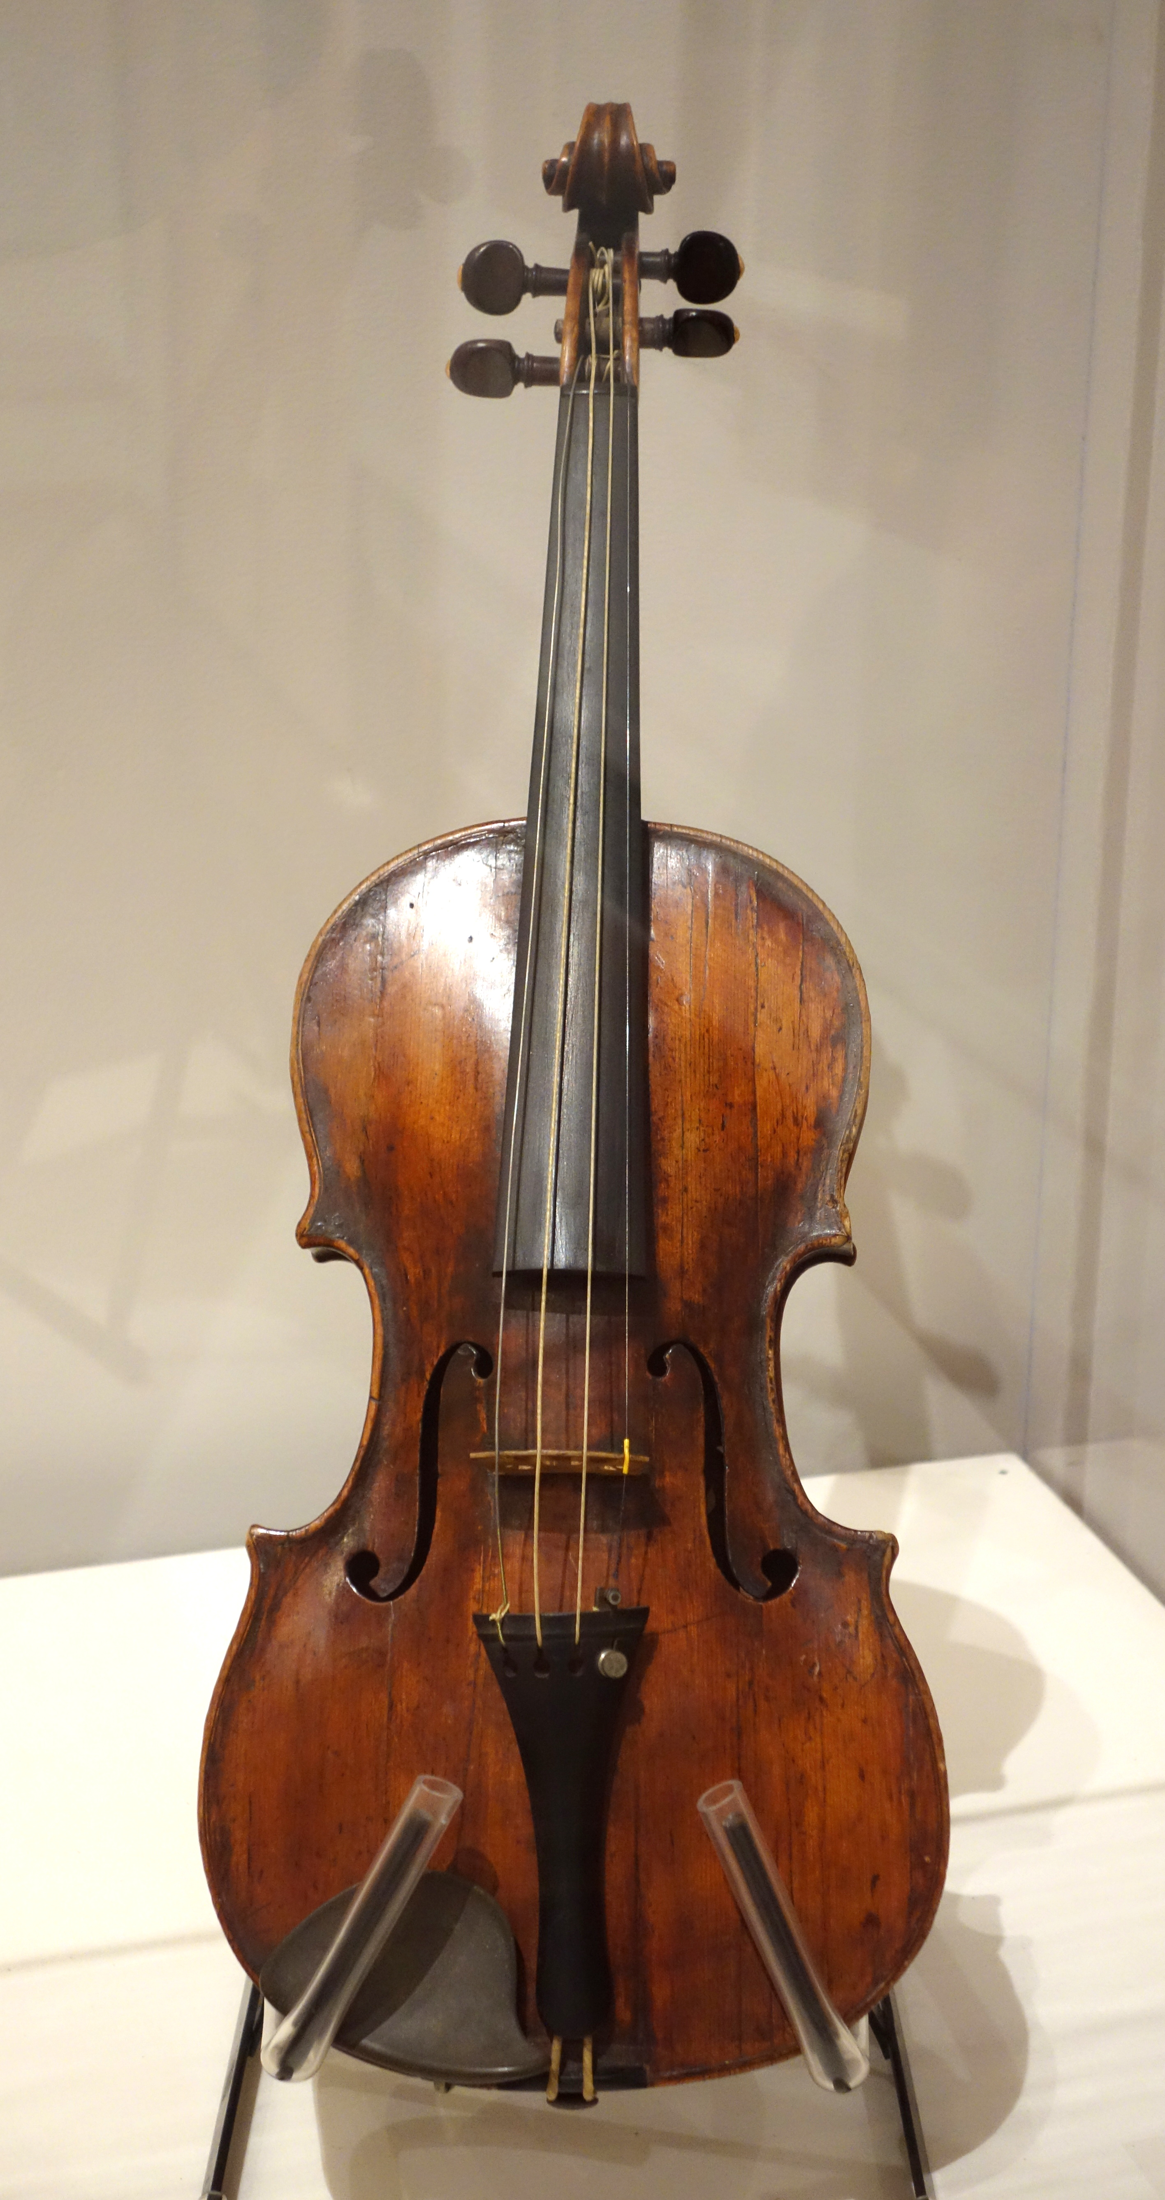
Reynolds v. Bagwell
Oklahoma 1948
p. 196

Slide 16
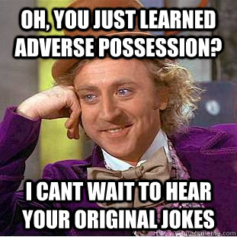
The Elements of Adverse Possession
Actual
Exclusive
Open & Notorious
Hostile
Continuous
SOL

Slide 17

O’Keefe v. Snyder
(New Jersey 1980) p. 199

Slide 18
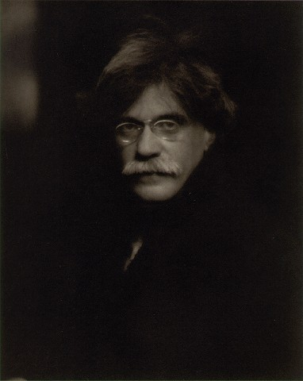


Slide 19



Slide 20
The Elements of Adverse Possession
Actual
Exclusive
Open & Notorious
Hostile
Continuous
SOL

Slide 21

Solomon R. Guggenheim Foundation v. Lubell
(New York 1991)

