Slide 1
Property
Class #5
February 22, 2016

Slide 2
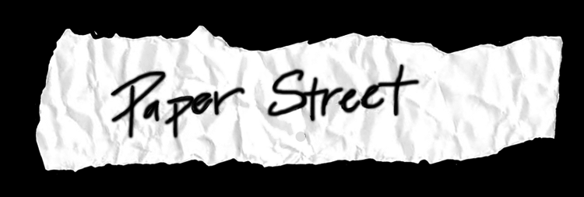
Tioga Coal Co. v. Supermarkets General Corp.
Pennsylvania 1988
p. 120/122

Slide 3
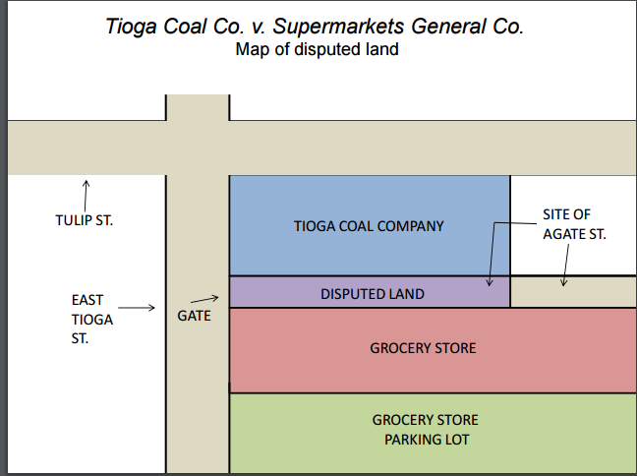

Slide 4
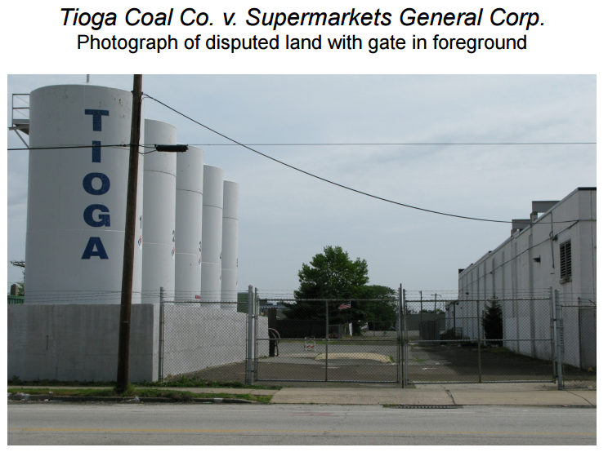

Slide 5
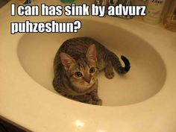
Elements of Adverse Possession
Actual
Exclusive
Open & Notorious
Adverse and Hostile
Continuous for the Statutory Period

Slide 6
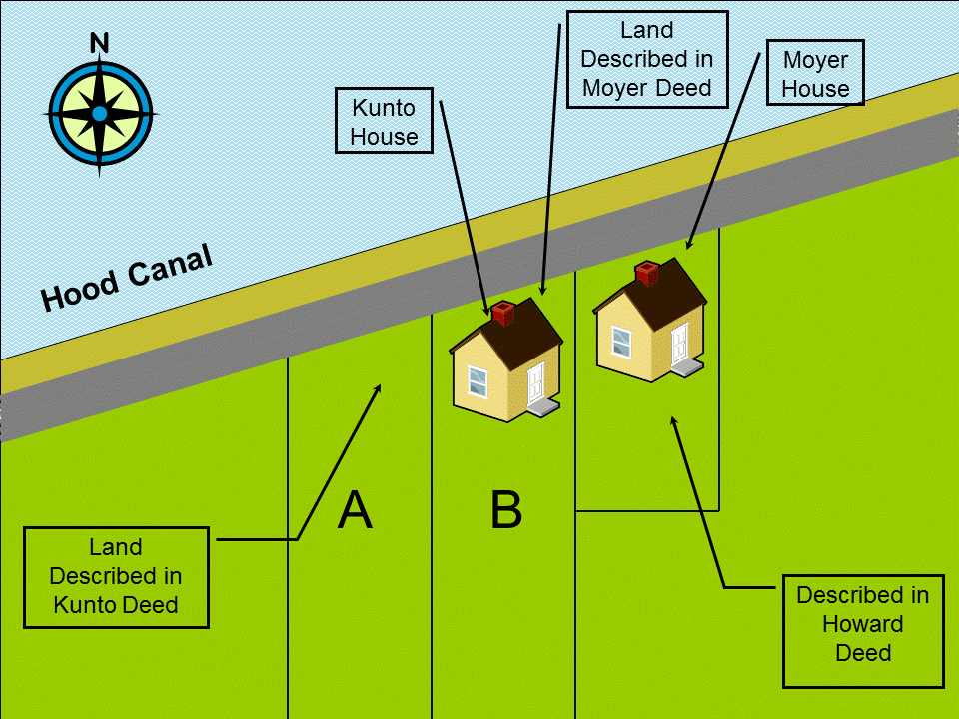
Howard v. Kunto
Washington 1970
P. 126/128

Slide 7
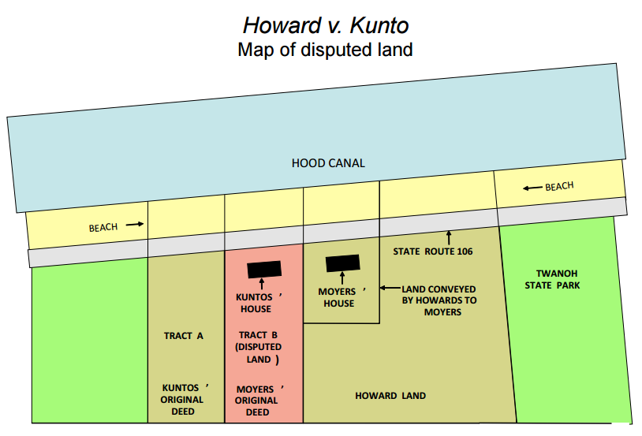

Slide 8
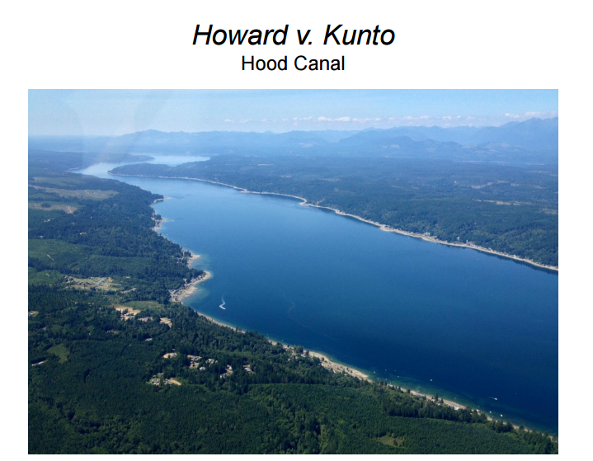

Slide 9
Elements of Adverse Possession
Actual
Exclusive
Open & Notorious
Adverse and Hostile
Continuous for the Statutory Period

Slide 10
Tacking Examples (Assume 10 year SOL)
Nathan occupies Tristan’s land for 6 years. Nathan then tells his buddy Dom “You can stay here if you want, but I am taking off.” Dom then stays 5 more years.
Jake occupies Jordan’s land for 2 years. Jake then tries to convey the land to his pal Sam, but the deed Jake uses is invalid. Sam occupies the land for 9 more years.

Slide 11
Tolling Example
Suppose Allie was 10 years old in 2000. Arthur begins adverse possession of her land in 2000. The AP SOL is 10 years, and the state allows suit 5 years of the removal of a disability. What is the earliest point Arthur could get the land?
Now suppose Allie dies in 2003. Arthur still entered in 2000. Allie left everything to Ben. However, Ben has been mentally incompetent since 2002.

Slide 12
Owning Personnel Property
Rule of Capture

Slide 13

State v. Shaw
Ohio 1902 p. 160

Slide 14
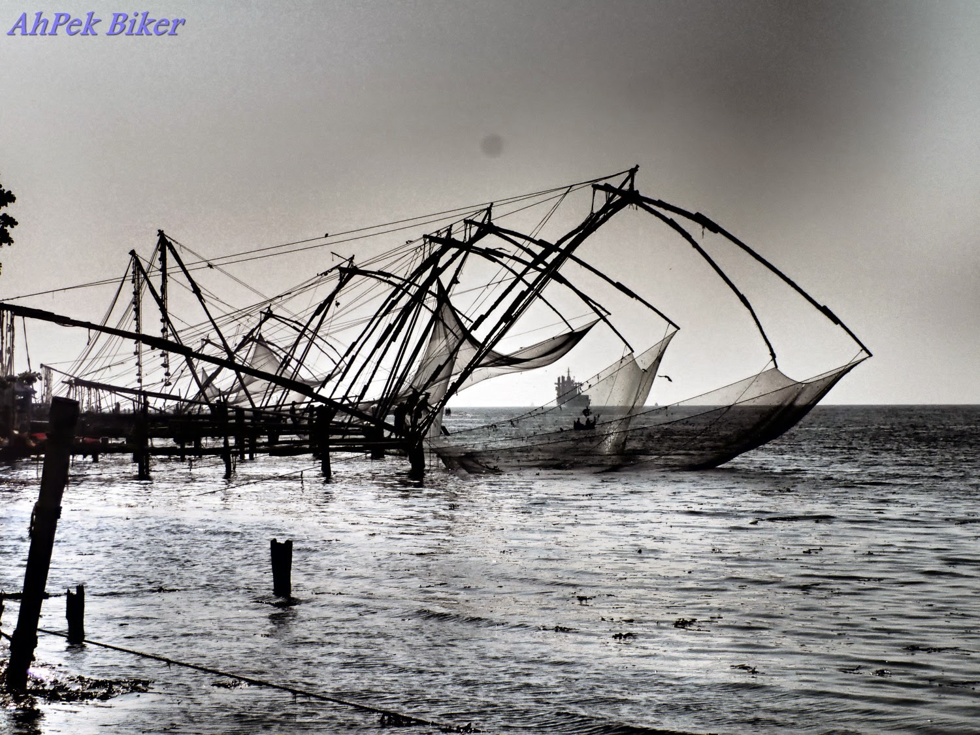

Slide 15
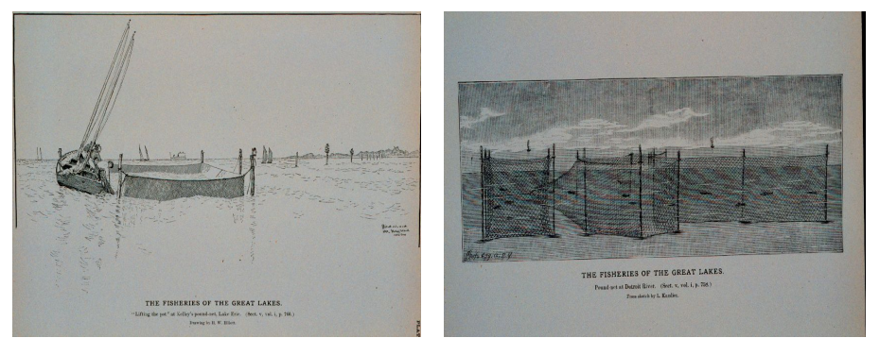

Slide 16
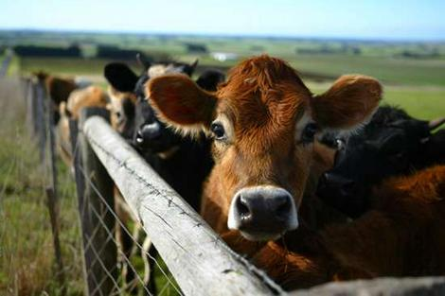
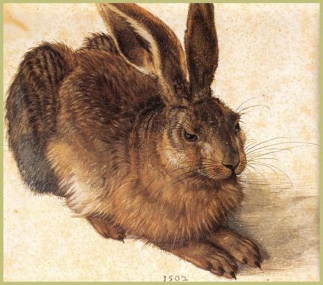
When do we own animals?
Animae Revertendi
Ferae Naturae

Slide 17

Pet Fox
Zach A. has a pet fox. It escapes and Allyson finds it. She wants to keep it for her own. Can Zach get it back?

Slide 18

Rhino Example
If Courtney grabs and subdues a rhinoceros running wildly down the streets of Amherst, does she get to keep it?

Slide 19
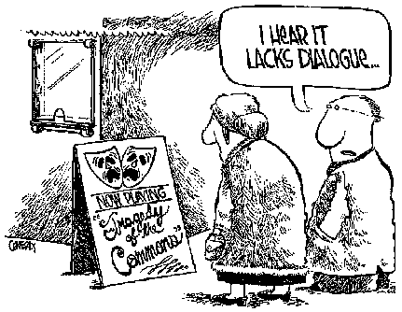
Tragedy of the Commons

Slide 20

Popov v. Hayashi
California 2002
p. 165

Slide 21
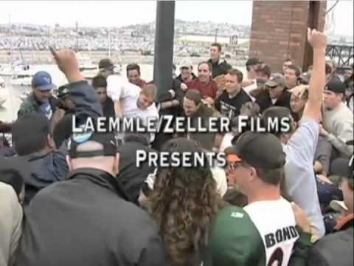

Slide 22
Baseball: Popov v. Hayashi
http://www.youtube.com/watch?v=rXpCKv6L1_8

Slide 23

Categories Found Chattels
Lost
Mislaid
Abandoned
Treasure Trove

Slide 24
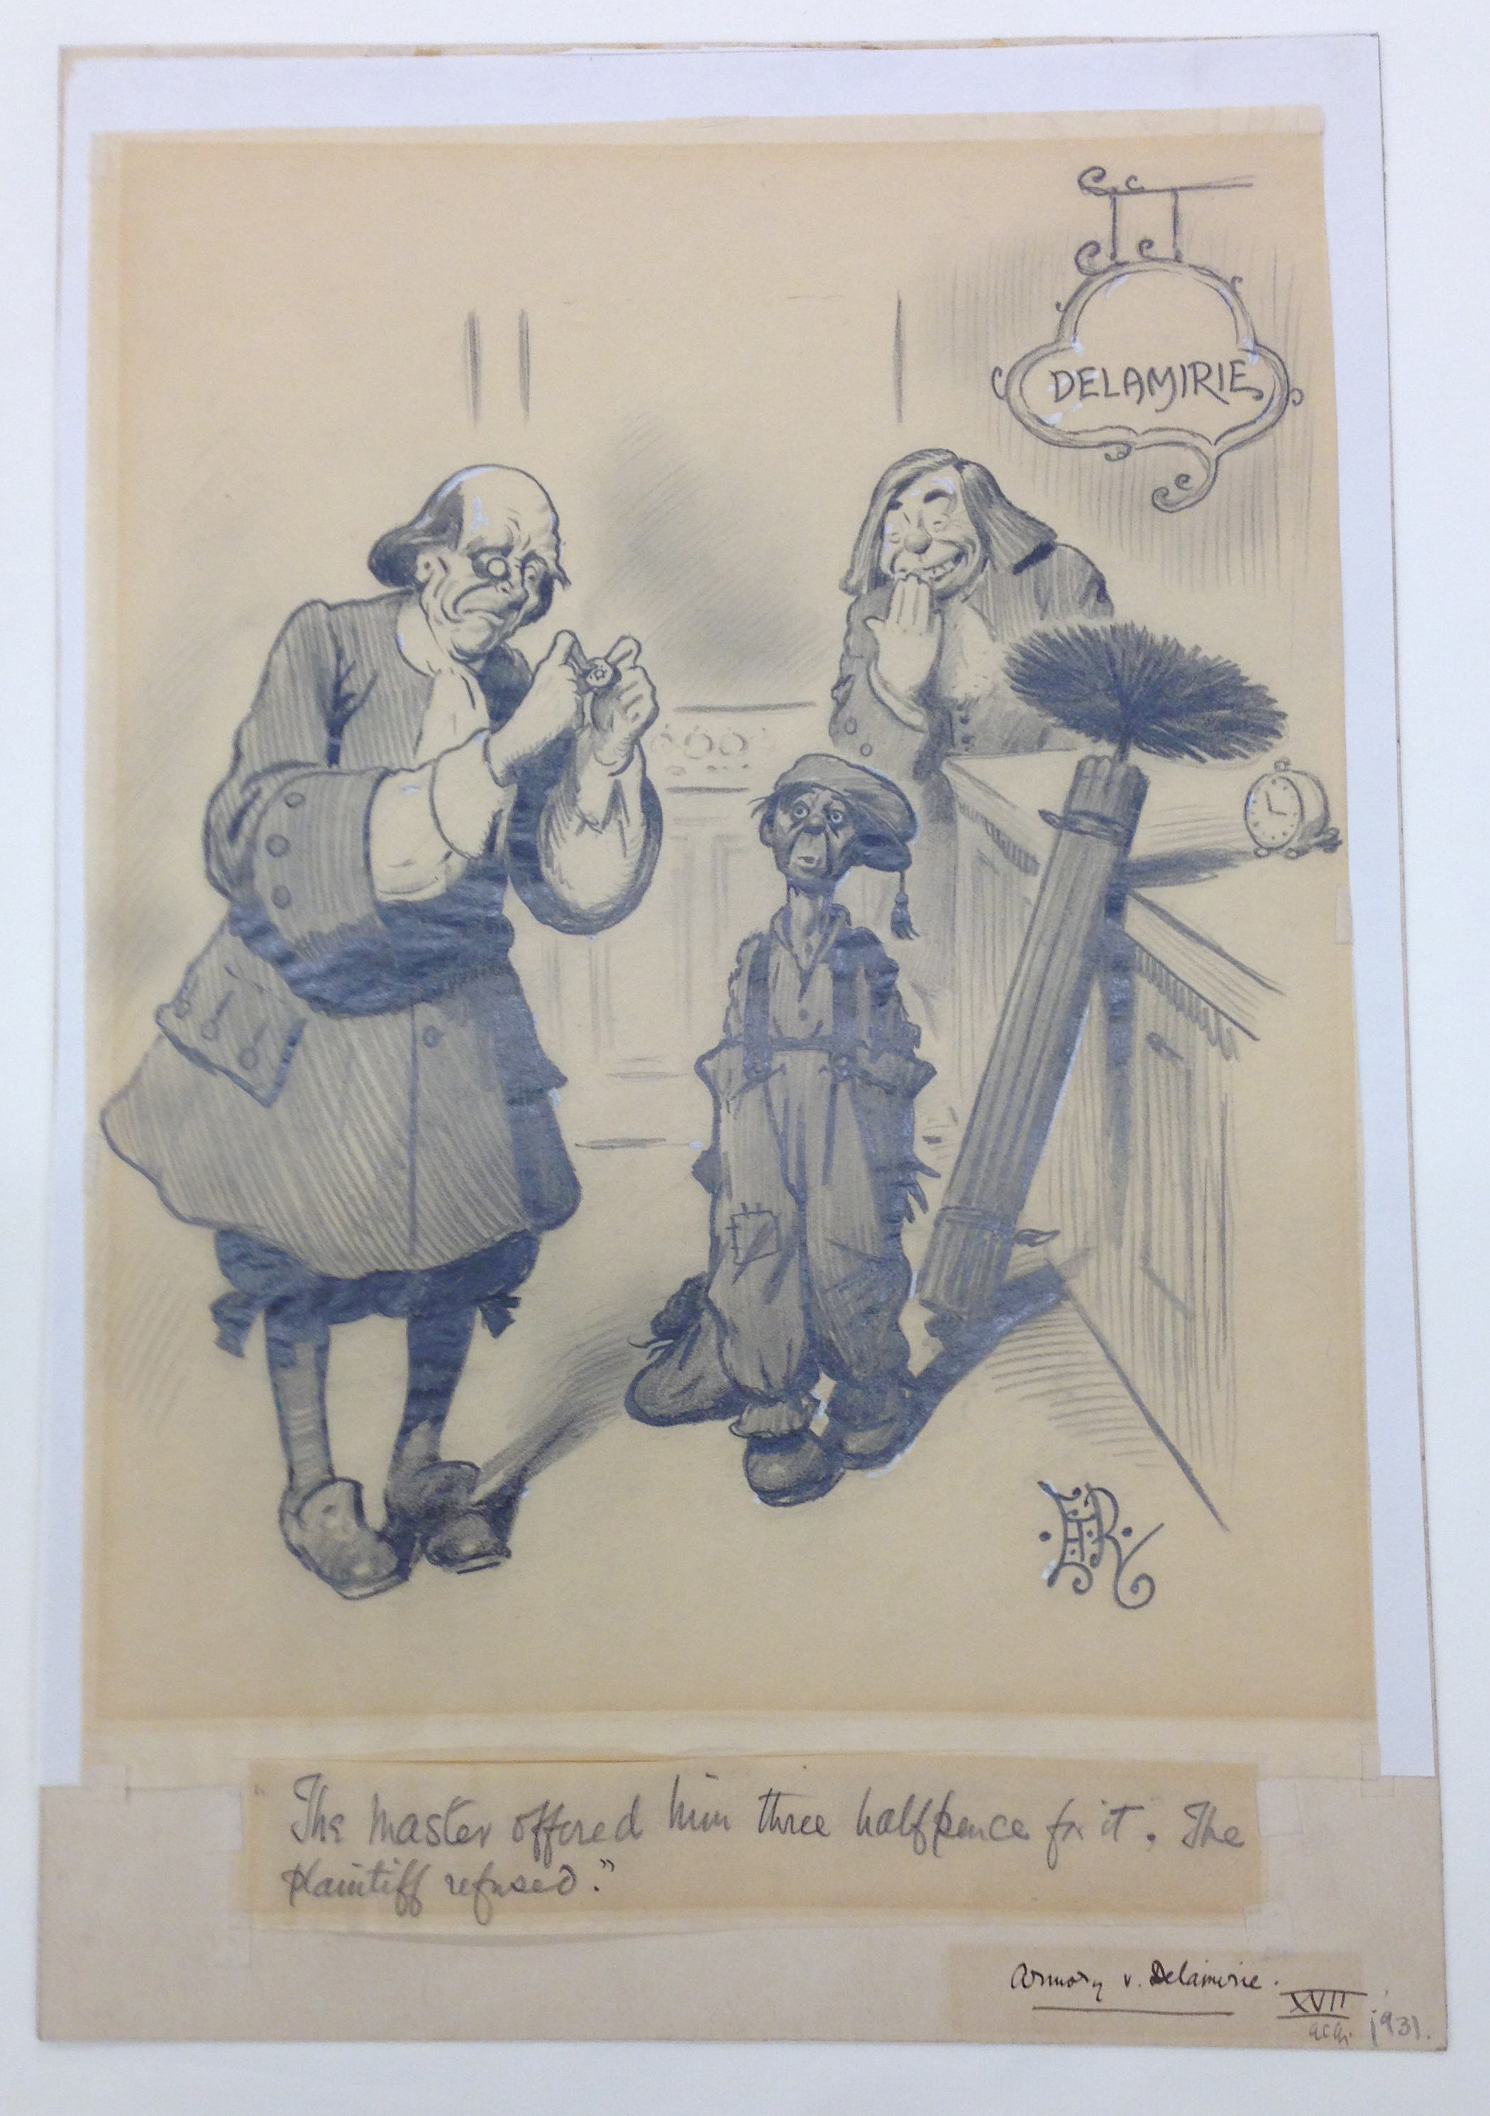
Armory v. DeLarimie
England 1722
p. 173/175

Slide 25
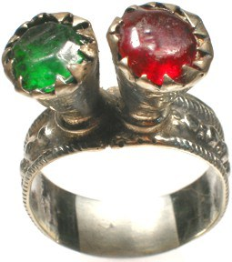
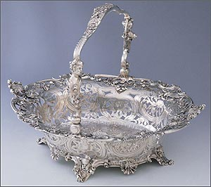

Slide 26
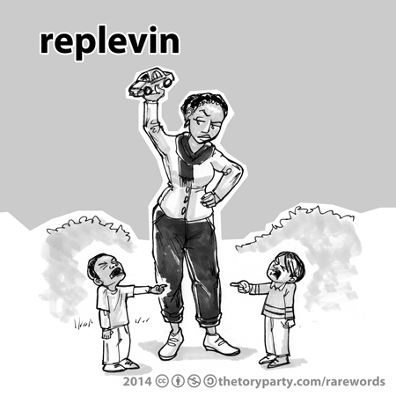

Common Law Property Causes of Action
Trover: Recovery of Damages
Replevin
Recovery of Property

