Slide 1
Property Law
Class #4
February 17, 2016

Slide 2

Bundle of Sticks
First Possession
Labor Theory
Utilitarian
Civic Republican Theory
Personhood

Slide 3

Adverse Possession

Slide 4
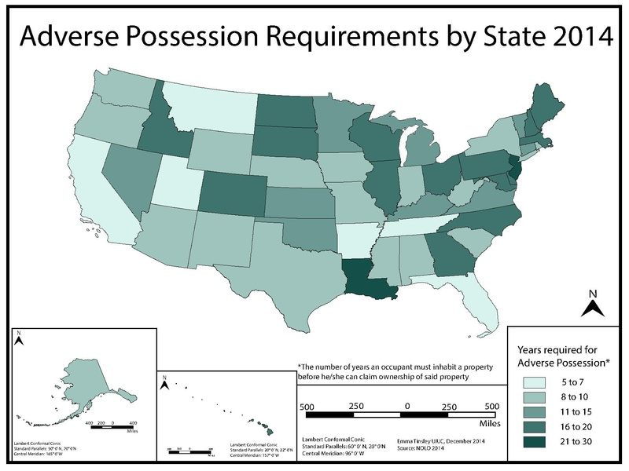

Slide 5

Policies Behind AP
To Encourage Productive Use of Land
Preventing Frivolous Land Claims
To Clear Up Title.
Favoring Possessors /Protecting Personhood

Slide 6
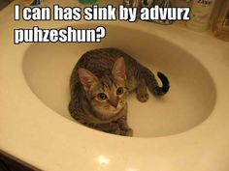
Elements of Adverse Possession
Actual
Exclusive
Open & Notorious
Adverse and Hostile
Continuous for the Statutory Period

Slide 7
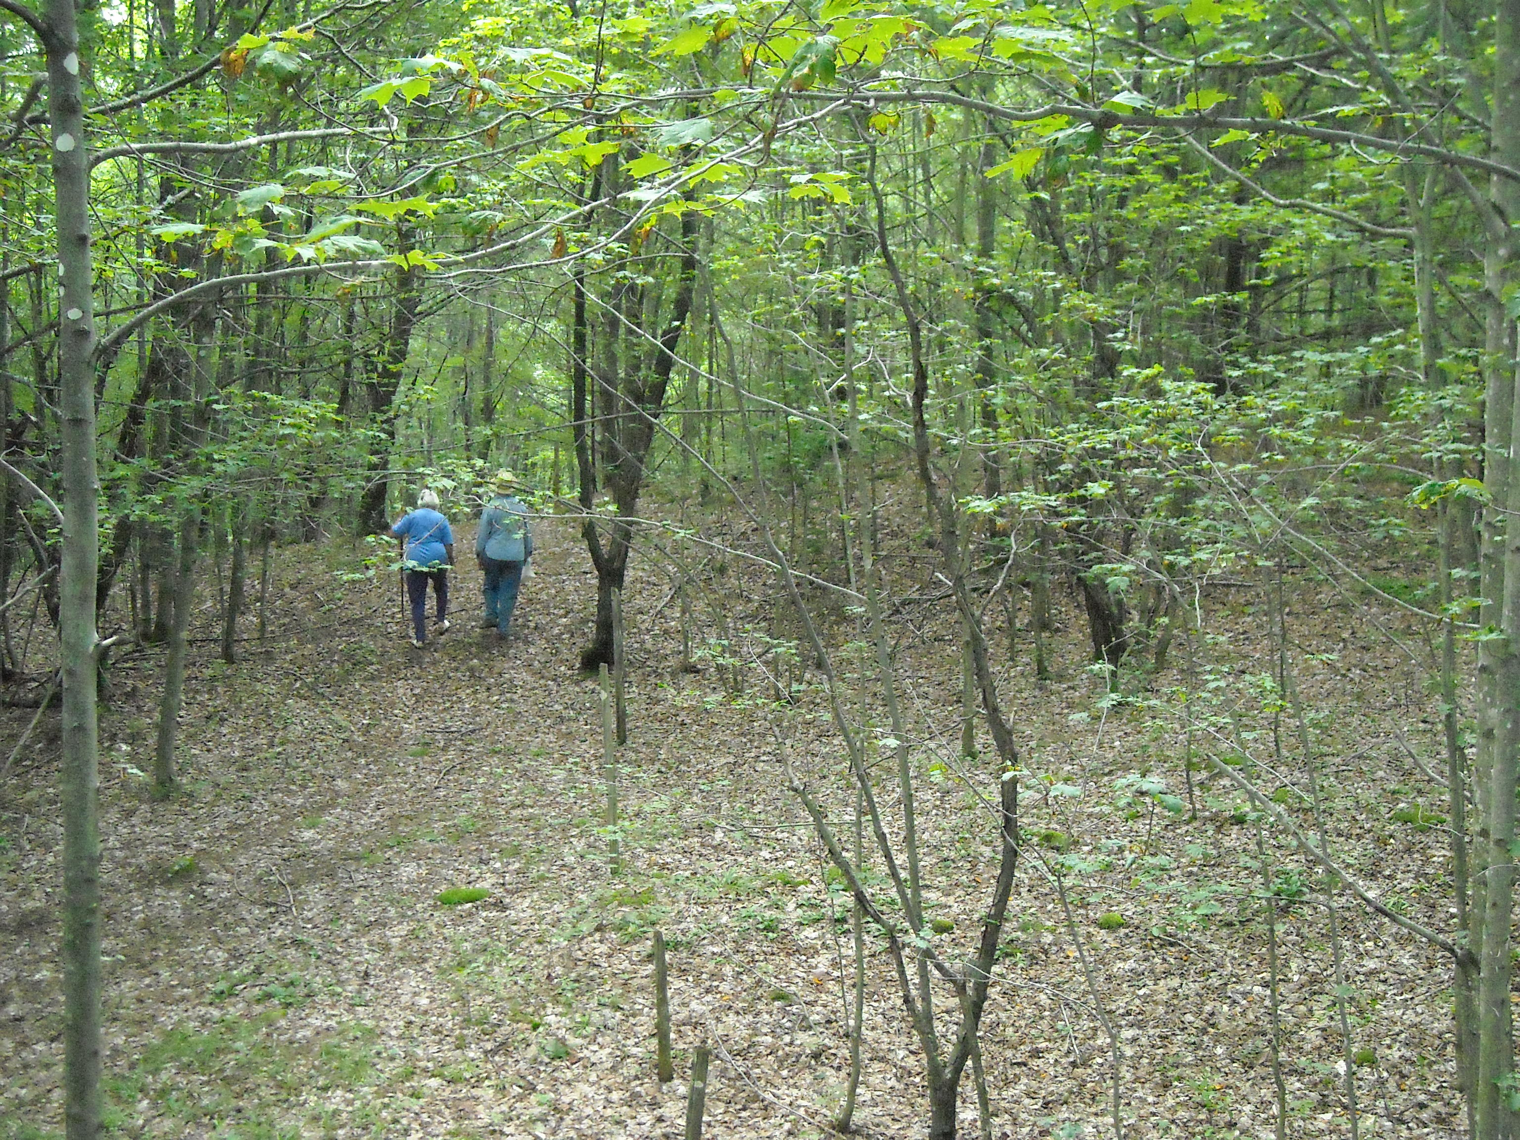
Gurwit v. Kannatzer
(Missouri 1990)
p. 101

Slide 8
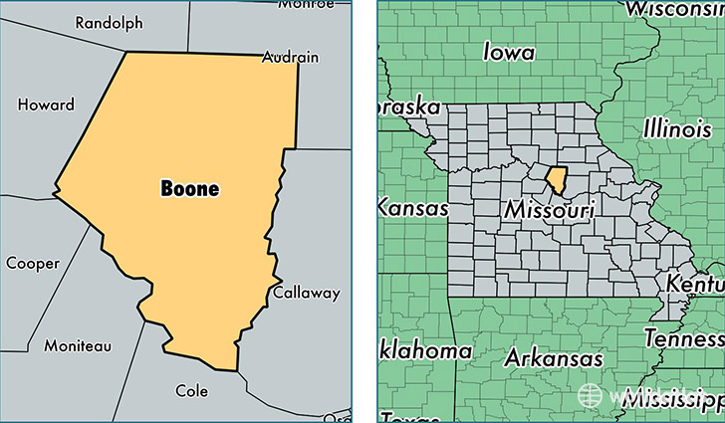

Slide 9
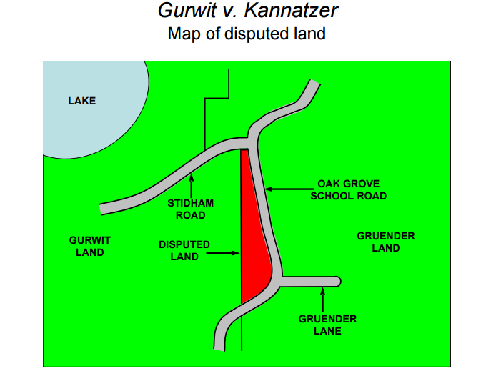

Slide 10
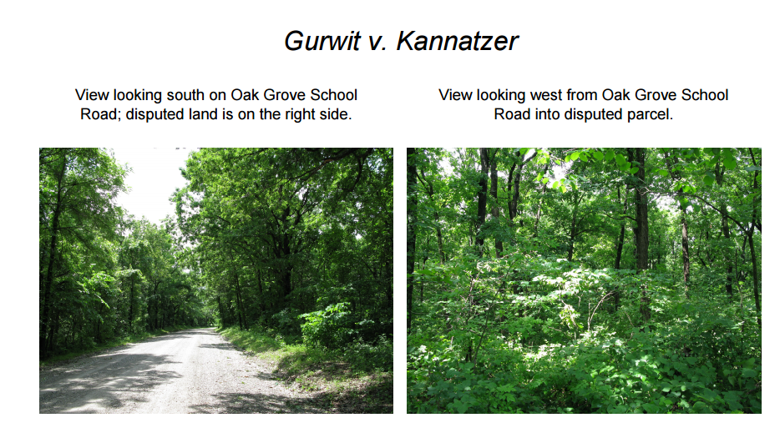

Slide 11
Elements of Adverse Possession
Actual
Exclusive
Open & Notorious
Adverse and Hostile
Continuous for the Statutory Period

Slide 12

Adverse Possession Problem
Jordan held title to a 200-acre tract of remote and unimproved desert land, which he never visited. Driving past the land one day, Ian notices that rare and valuable cacti grew there. Ian spent 20 minutes digging out four small cacti, which he later sold. Over the next 10 years, Ian visited the property on 5 more occasions, each time removing a few cacti. Ian now claims title to the tract

Slide 13

Adverse Possession Problem
Christian owned a home in a rural subdivision. Peter purchased the house next door. All backyards in the subdivision were unfenced and covered by wild grass. Over the next 10 years, Christian occasionally watered the wild grass behind his house. He also mowed it 3 or 4 times each summer. Christian then discovered that part of the land he had been watering and mowing (a strip about 20 feet wide) was actually part of Peter’s original lot. Over the years, Christian’s children had played on this strip of land on 8 or 9 occasions. Peter claims title.

Slide 14
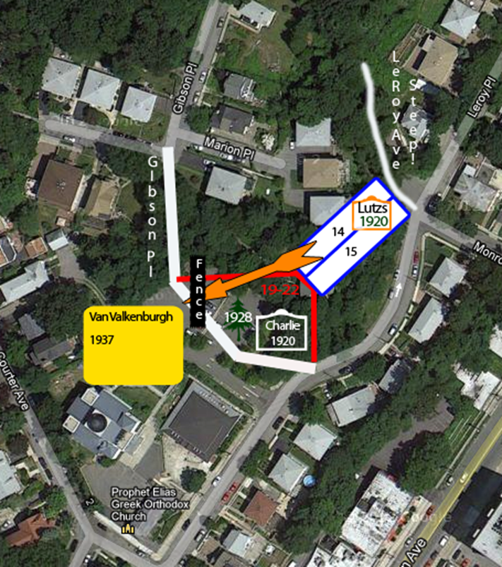
Van Valkenburgh v. Lutz
(New York 1952) p. 105/107

Slide 15
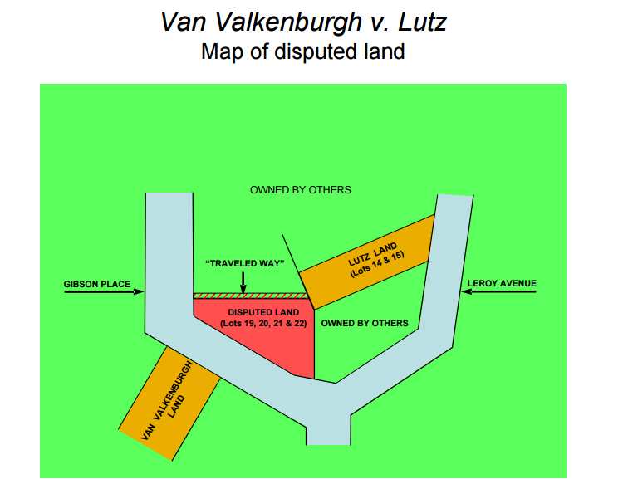

Slide 16
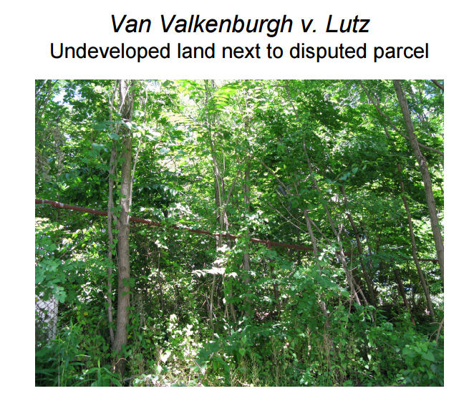

Slide 17
Elements of Adverse Possession
Actual
Exclusive
Open & Notorious
Adverse and Hostile
Continuous for the Statutory Period

Slide 18

Claim of Title
Good Faith
Bad Faith
Subjective Standard
Objective Standard
Irrelevant

Slide 19
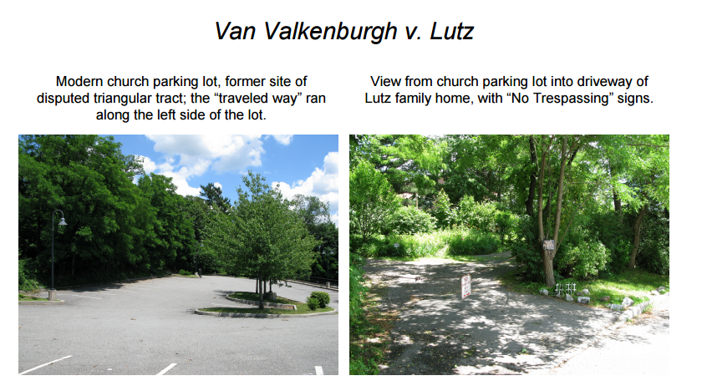

Slide 20
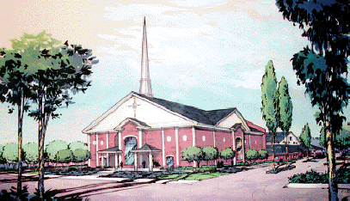
Fulkerson v. Van Buren
(Arkansas 1998)
p. 114

Slide 21
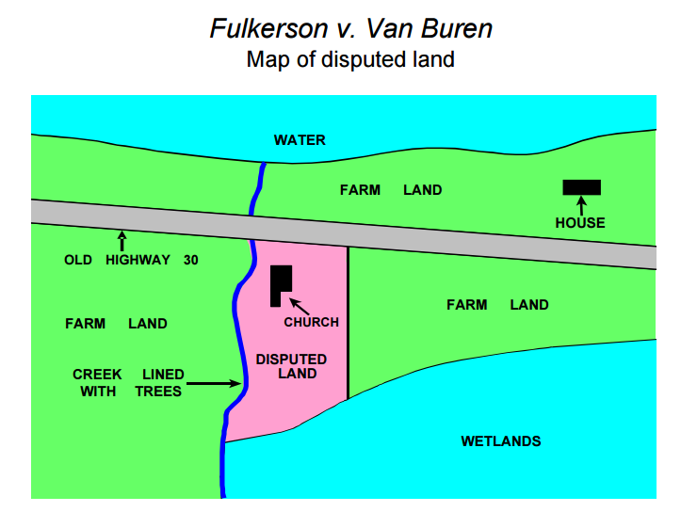

Slide 22
