Slide 1
Property
Class #3
Monday February 15, 2016

Slide 2
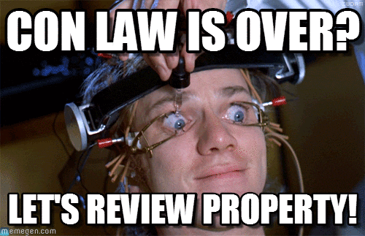
Five Theories of Property Law
First Possession
Labor Theory
Utilitarian
Civic Republican Theory
Personhood

Slide 3
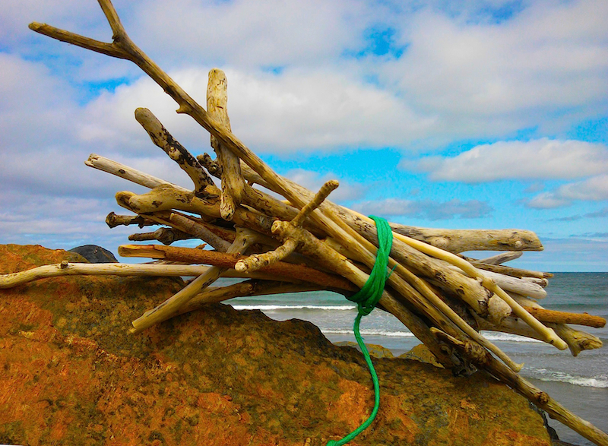
Bundle of Sticks
Right to Transfer
Right to Exclude
Right to Use
Right to Destroy
Notes:
Bundle of Sticks Metaphor
Let’s name some sticks:
Right to use, right to exclude, right to manage, right to income, right to capital, right to transfer
What about duties?
Heller: while the modern bundle of sticks metaphor reflects well the possibility of complex relational fragmentation, it gives a weak sense of the thingness of private property.
If we focus too narrowly on any given right with respect to a thing and conceive of that right independently from other rights in the thing, our conception of property as a distinctive institution begins to fall apart, replaced by disaggregated strands of rights and duties among particular people.

Slide 4
Bundle of Sticks
Right to Transfer
Right to Exclude
Right to Use
Right to Destroy
Notes:
Bundle of Sticks Metaphor
Let’s name some sticks:
Right to use, right to exclude, right to manage, right to income, right to capital, right to transfer
What about duties?
Heller: while the modern bundle of sticks metaphor reflects well the possibility of complex relational fragmentation, it gives a weak sense of the thingness of private property.
If we focus too narrowly on any given right with respect to a thing and conceive of that right independently from other rights in the thing, our conception of property as a distinctive institution begins to fall apart, replaced by disaggregated strands of rights and duties among particular people.

Slide 5
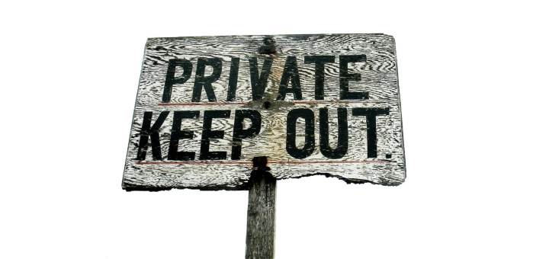
The Right to Exclude

Slide 6
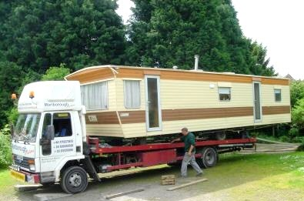
Jacque v. Steenberg Homes
563 N.W.2d 154 (Wis. 1997) (Bablitch, J.) p. 51

Slide 7
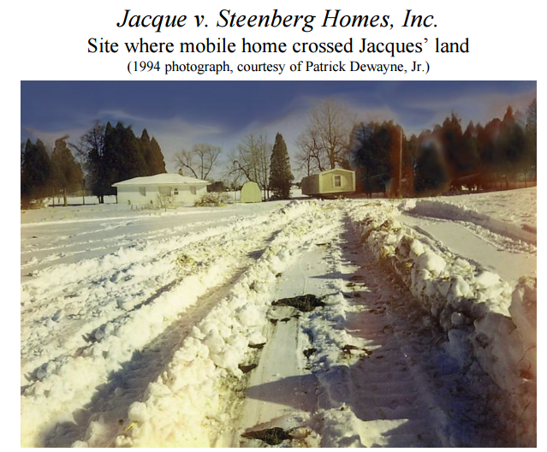

Slide 8
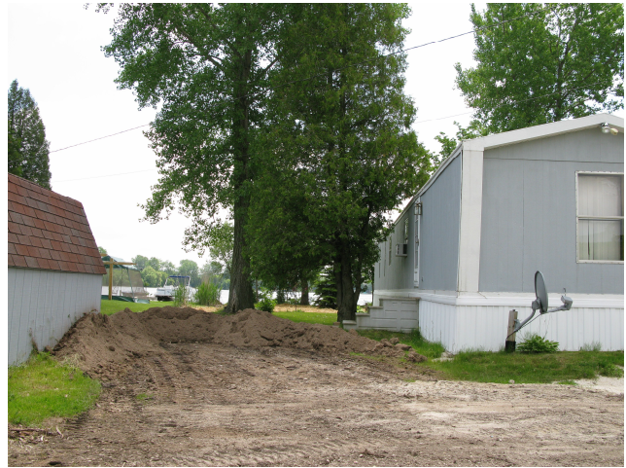

Slide 9
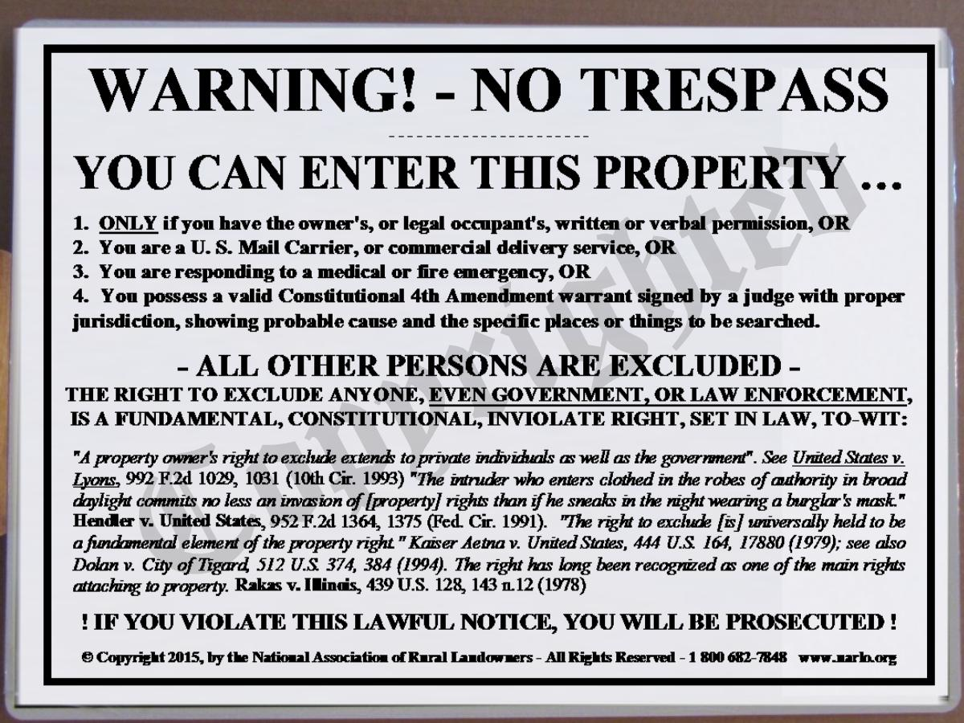

Slide 10
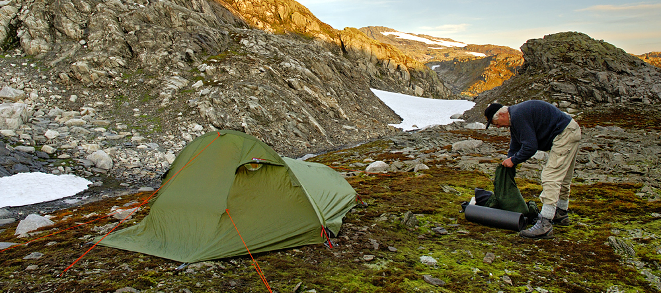

Slide 11
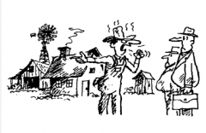
State v. Shack
277 A.2d 369 (N.J. 1971) (Weintraub, C.J.)
p. 59

Slide 12
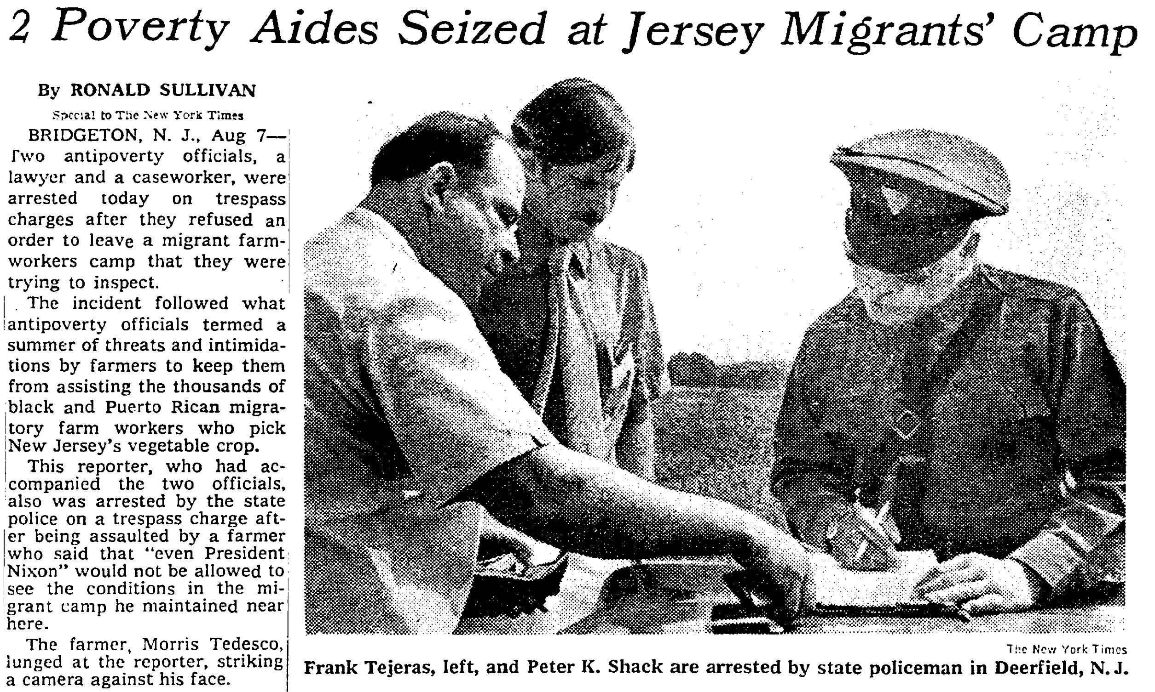

Slide 13
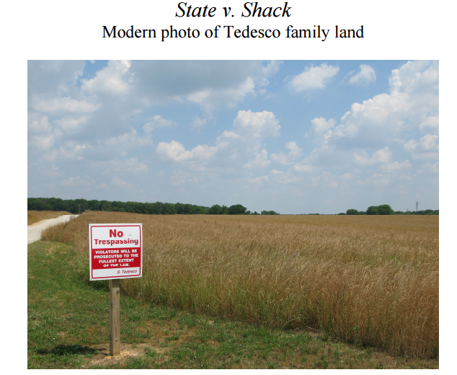

Slide 14

Doctrine of Necessity

Slide 15
Thresholds of Necessity?
Suppose Sam’s house is on fire and the flames may spread to nearby houses, Sam refuses to allow firefighters to enter her property. Does she have the right to exclude them?
What if Sam’s house is not yet on fire, but is about to burst into flame due to a smoldering ember? Do the firefighters get to enter?
Or Kayla’s house is in danger of catching fire from flames on an adjacent building because Kayla has failed to clear the dry brush from around her rural home? Will her right to exclude keep firefighters away?

Slide 16
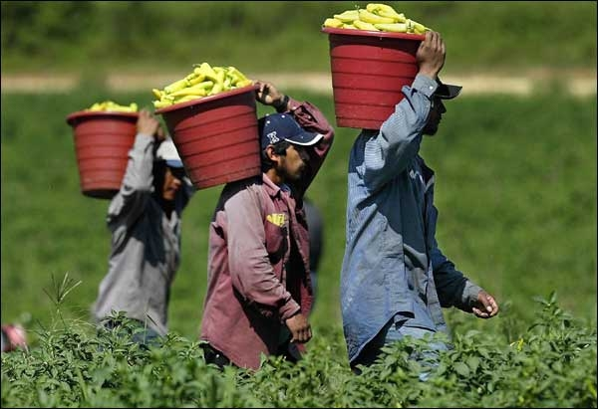
Implied Statutory Right of Access?

Slide 17
Utilitarian Balancing
“Property rights serve human values. They are recognized to that end and are limited by it.”

Slide 18
Bundle of Sticks
Right to Transfer
Right to Exclude
Right to Use
Right to Destroy
Notes:
Bundle of Sticks Metaphor
Let’s name some sticks:
Right to use, right to exclude, right to manage, right to income, right to capital, right to transfer
What about duties?
Heller: while the modern bundle of sticks metaphor reflects well the possibility of complex relational fragmentation, it gives a weak sense of the thingness of private property.
If we focus too narrowly on any given right with respect to a thing and conceive of that right independently from other rights in the thing, our conception of property as a distinctive institution begins to fall apart, replaced by disaggregated strands of rights and duties among particular people.

Slide 19
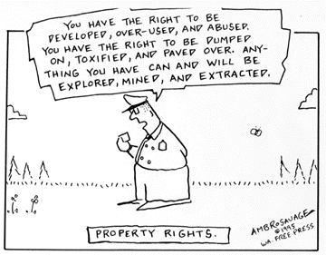
Right to Use

Slide 20
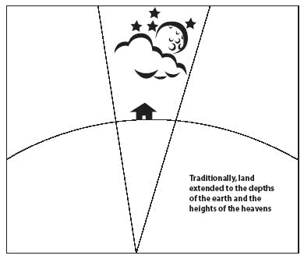
Cujus est Solum, ejus est usque ad coelom et ad infernos.

Slide 21

Sic Utero Tuo Ut Alienum Non Laedas

Slide 22
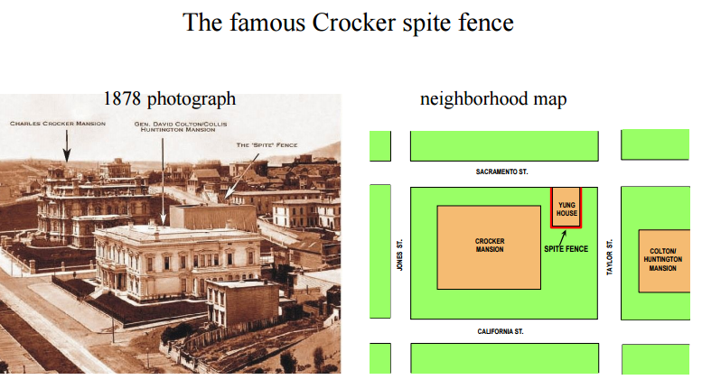

Slide 23
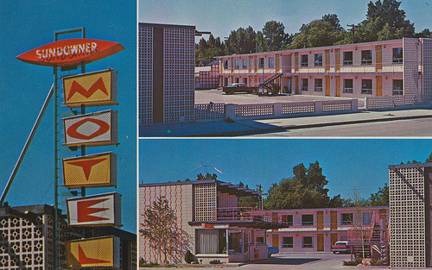
Sundowner Inc. v. King
Idaho 1973
p. 71

Slide 24

Prah v. Maretti
(Wis. 1982)
p. 73

Slide 25
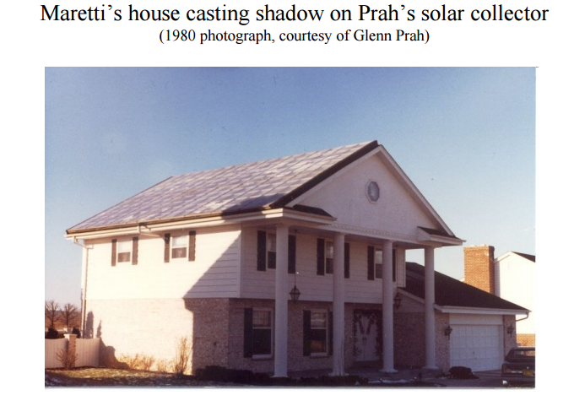

Slide 26
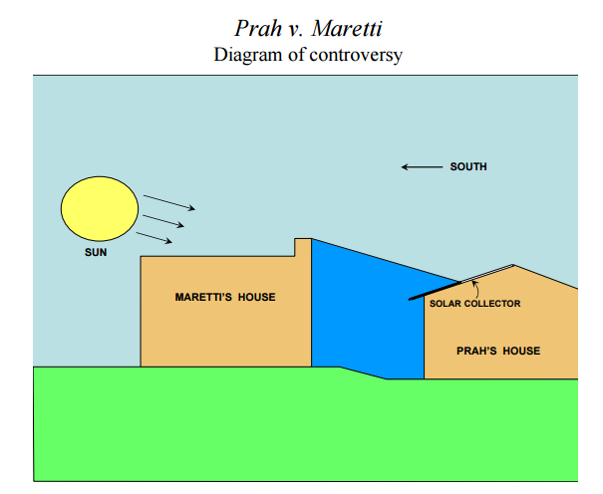

Slide 27
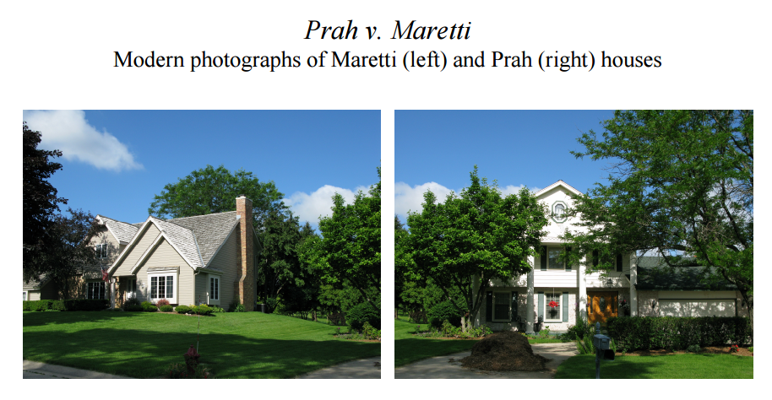

Slide 28
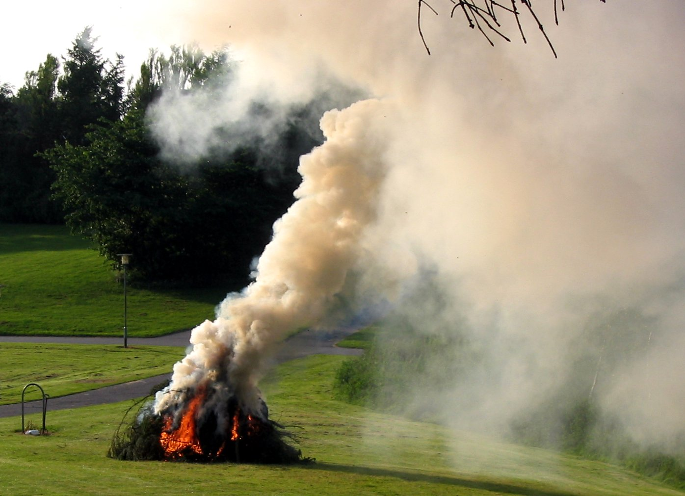
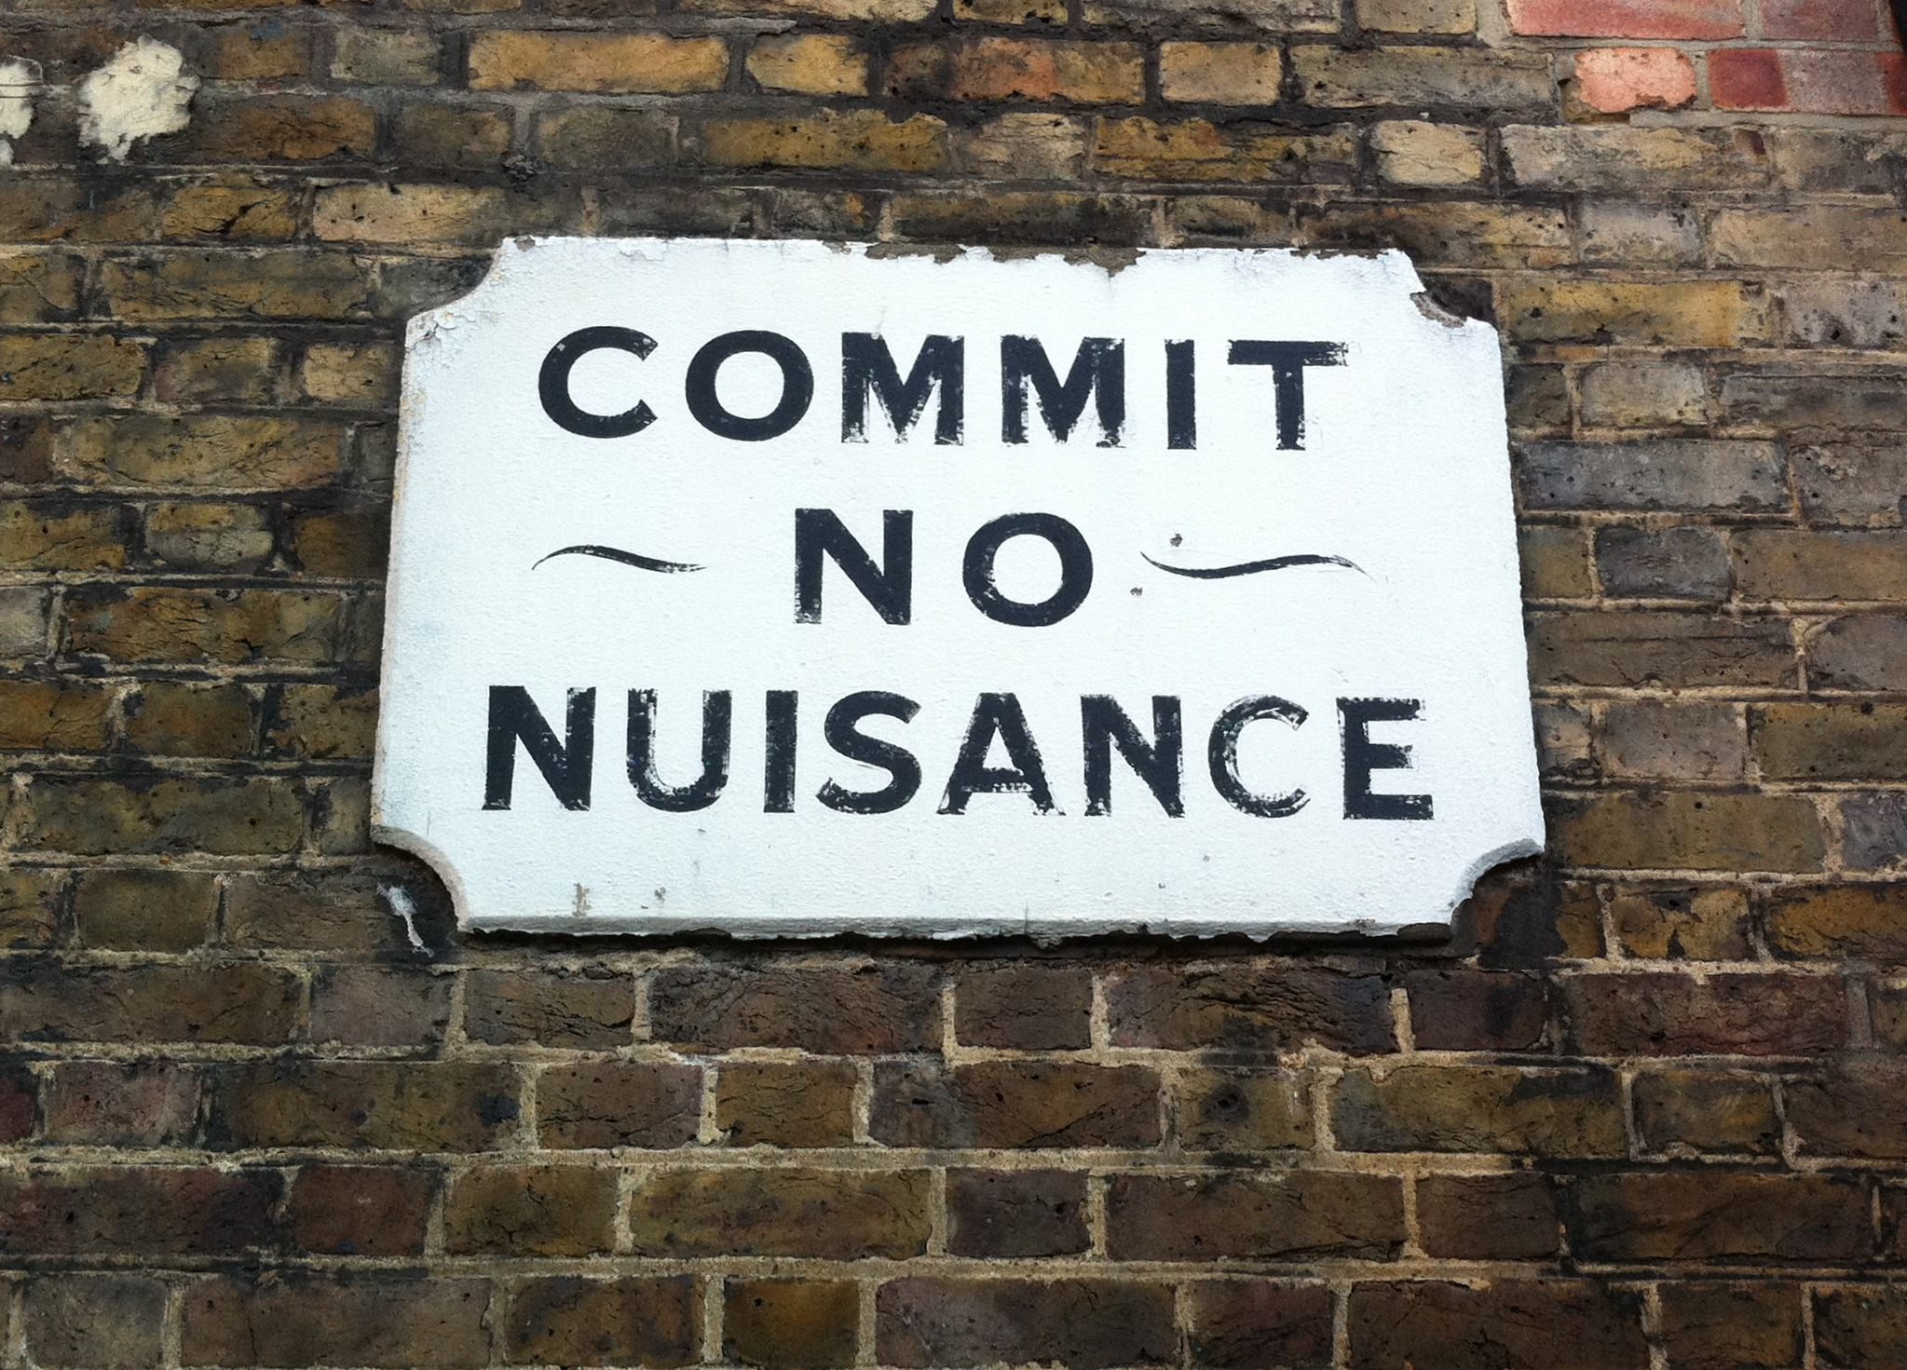
Nuisance

Slide 29
Should we apply Nuisance?
Charlie constructs a windmill in his backyard to generate electricity. Matt now proposes to build a home on his adjacent lot, which will partially block the flow of wind. Should the court apply nuisance law?

Slide 30
Bundle of Sticks
Right to Transfer
Right to Exclude
Right to Use
Right to Destroy
Notes:
Bundle of Sticks Metaphor
Let’s name some sticks:
Right to use, right to exclude, right to manage, right to income, right to capital, right to transfer
What about duties?
Heller: while the modern bundle of sticks metaphor reflects well the possibility of complex relational fragmentation, it gives a weak sense of the thingness of private property.
If we focus too narrowly on any given right with respect to a thing and conceive of that right independently from other rights in the thing, our conception of property as a distinctive institution begins to fall apart, replaced by disaggregated strands of rights and duties among particular people.

Slide 31
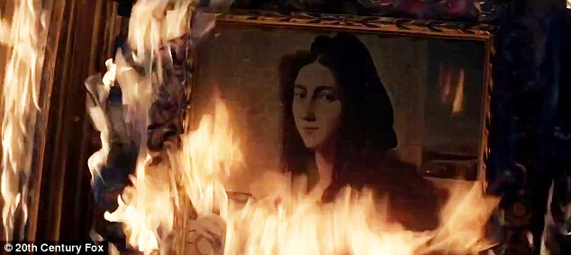
Right to Destroy

Slide 32
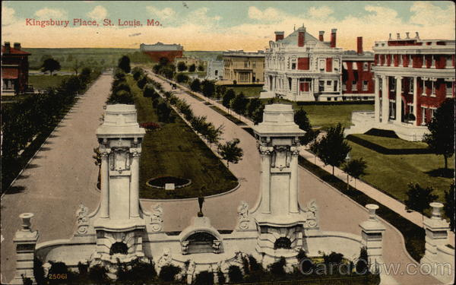
Eyerman v. Mercantile Trust Co.
Missouri 1975
p. 84

Slide 33
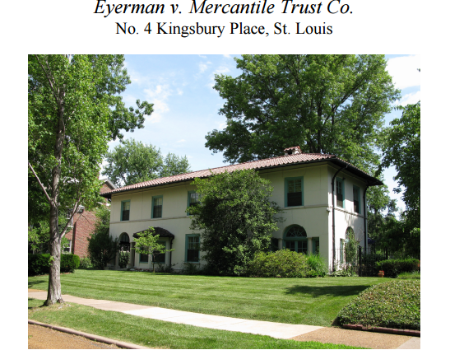

Slide 34
A well-ordered society cannot tolerate the waste and destruction of resources when such acts directly affect important interests of other members of that society.

