Slide 1
Property Class #1
February 8, 2016

Slide 2
Basic Info
Jessica Owley, Room 722, 645-8182 or jol@buffalo.edu
Office Hours: Monday 3:30-5 and Thursdays 12:30-4 plus by appointment
Secretary in flux: Sandi (717), Sue (5th Floor), Debbie
Computer Policy and Website
Facebook Group

Slide 3
Index Cards
Full name (include what you want to be called)
Hometown
Undergraduate college and major (and graduate degree if applicable)
Interesting job or jobs you have had
A favorite hobby or two
Favorite book or movie

Slide 4
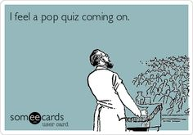

Slide 5


Slide 6
Definitions of Property
Blackstone: That sole and despotic dominion which one man claims and exercises over the external things of the world, in total exclusion of the right of any other individual or universe.
Hohfield: There is no such thing as a right in a thing (an in rem right). What you really have are rights against each other. Property is about relationships between people. Property is then a loosely organized bundle of rights that people have against one another.
Notes:
Some commentators have argued that the concept of property defies definition.
Thomas Grey (1980):
How do property rights differ from rights generally from human rights or personal rights or rights to life or liberty, say? Our specialists and theoreticians have no answer; or rather, they have a multiplicity of widely different answers, related only in that they bear some association or analogy, more or less remote, to the common notion of property as the ownership of things.… It seems fair to conclude from a glance at the range of current usages that the specialists who design and manipulate legal structures of the advanced capitalist economies could easily of without using the term “property” at all.

Slide 7
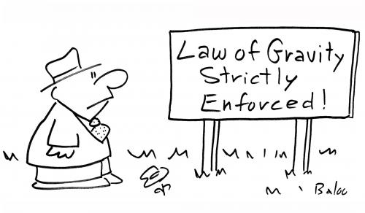
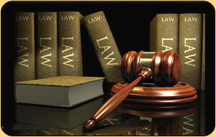
Why Do We Have Property?
Natural Law
Legal Positivism

Slide 8

Five Theories of Property
First Possession

Slide 9
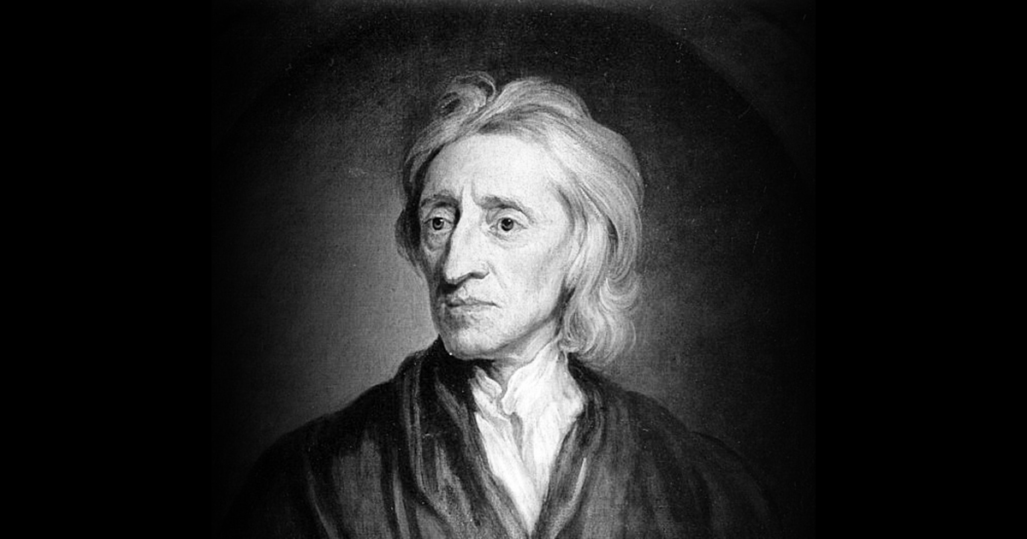
Five Theories of Property
First Possession
Labor Theory

Slide 10

Five Theories of Property
First Possession
Labor Theory
Utilitarian

Slide 11

Five Theories of Property
First Possession
Labor Theory
Utilitarian
Civic Republican Theory

Slide 12
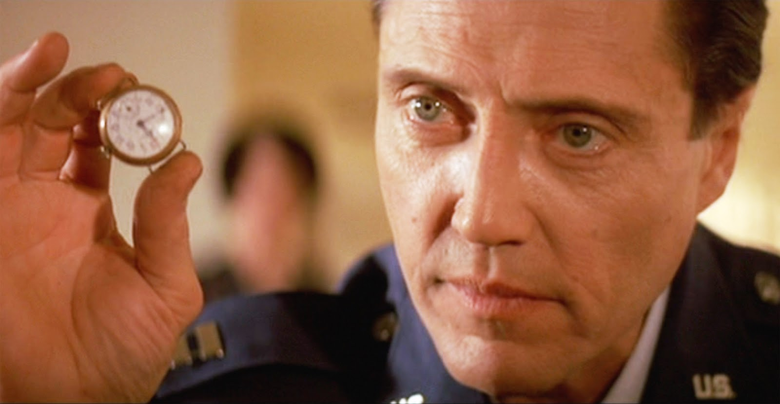
Five Theories of Property
First Possession
Labor Theory
Utilitarian
Civic Republican Theory
Personhood

Slide 13

Pierson v. Post
3 Cai. R. 175 (Supreme Court of New York 1805)
p. 8

Slide 14
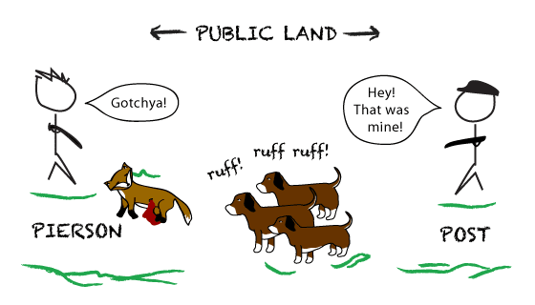

Slide 15
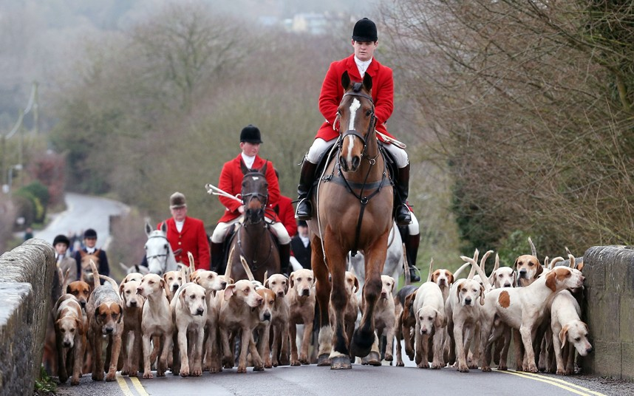
Five Theories of Property
First Possession
Labor Theory
Utilitarian
Civic Republican Theory
Personhood

Slide 16
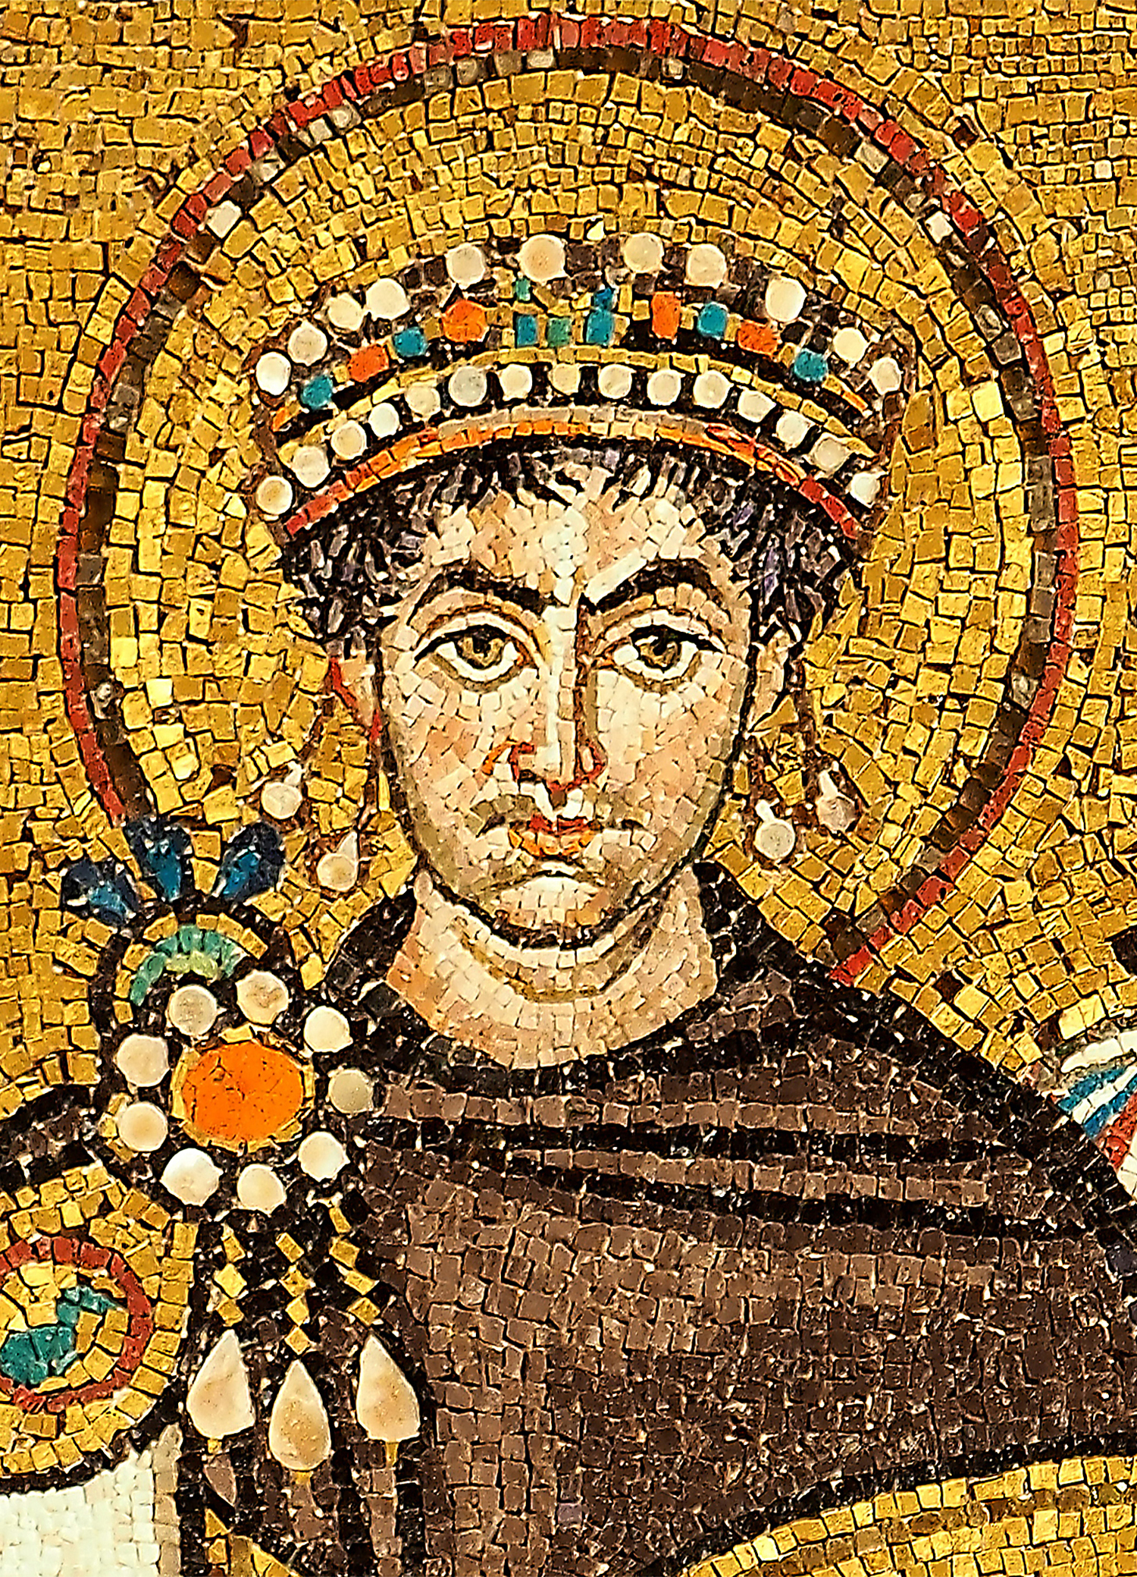
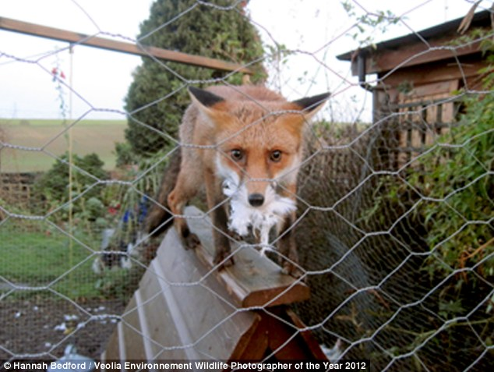
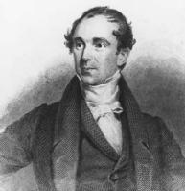
Public Policy
Majority
Dissent

Slide 17
Hypo One: Who Holds Title?
Post shoots at a deer from a location 200 feet away; the shot grazes the deer’s ear and temporarily stuns it. Pierson immediately snatches the deer and puts it in a large sack. Post arrives on the scene one minute later, while the deer is still stunned.

Slide 18
Hypo Two: Who Holds Title?
Motivated by environmental concerns, Posts nets a wild rabbit, paints “Property of Post “ on it, and then allows it to run free. Pierson shoots and kills the rabbit.

Slide 19
Hypo Three: Who Holds Title?
Post’s does chase a fox into a shallow cave. But before Post can get to the cave, Pierson shoots the fox and mortally wounds it. Post arrives at the cave two minutes later.

Slide 20
Hypo Four: Who Holds Title?
Post’s cow strays onto unowned land. Pierson finds the cow, places a rope around its neck, and leads it back to his own farm. Two days later, Post discovers the cow on Pierson’s farm.

Slide 21
White v. Samsung Electronics
971 F.2d 1395 (9th Cir. 1992) (Goodwin, S.J.)

Slide 22
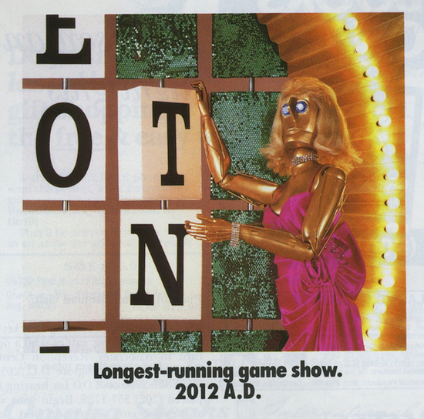


Slide 23
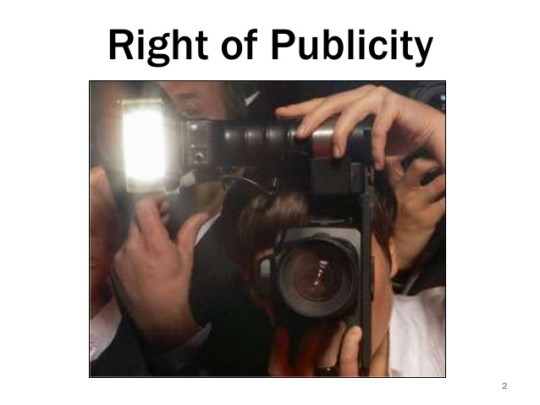
Five Theories of Property
First Possession
Labor Theory
Utilitarian
Civic Republican Theory
Personhood

Slide 24
Hypo Five: Right of Publicity
A sells a video football game that features virtual players. The jersey number, height, weight, hometown, and playing statistics for each virtual player are the same as currently-enrolled college player, but the name and the likeness of the actual player are not used. Has A’s right of publicity been violated?

Slide 25
Hypo Six: Right of Publicity
B writes a book about the impact of Martin Luther King, Jr. on the civil rights movement. The book is sold to the public. Has MLK’s right of publicity been violated?

Slide 26
Hypo Seven: Right of Publicity
C invents a new dance style that reminds some people of the way Michael Jackson danced. C is paid to perform the dance on a television show. Has MJ’s right of publicity been violated?

Slide 27
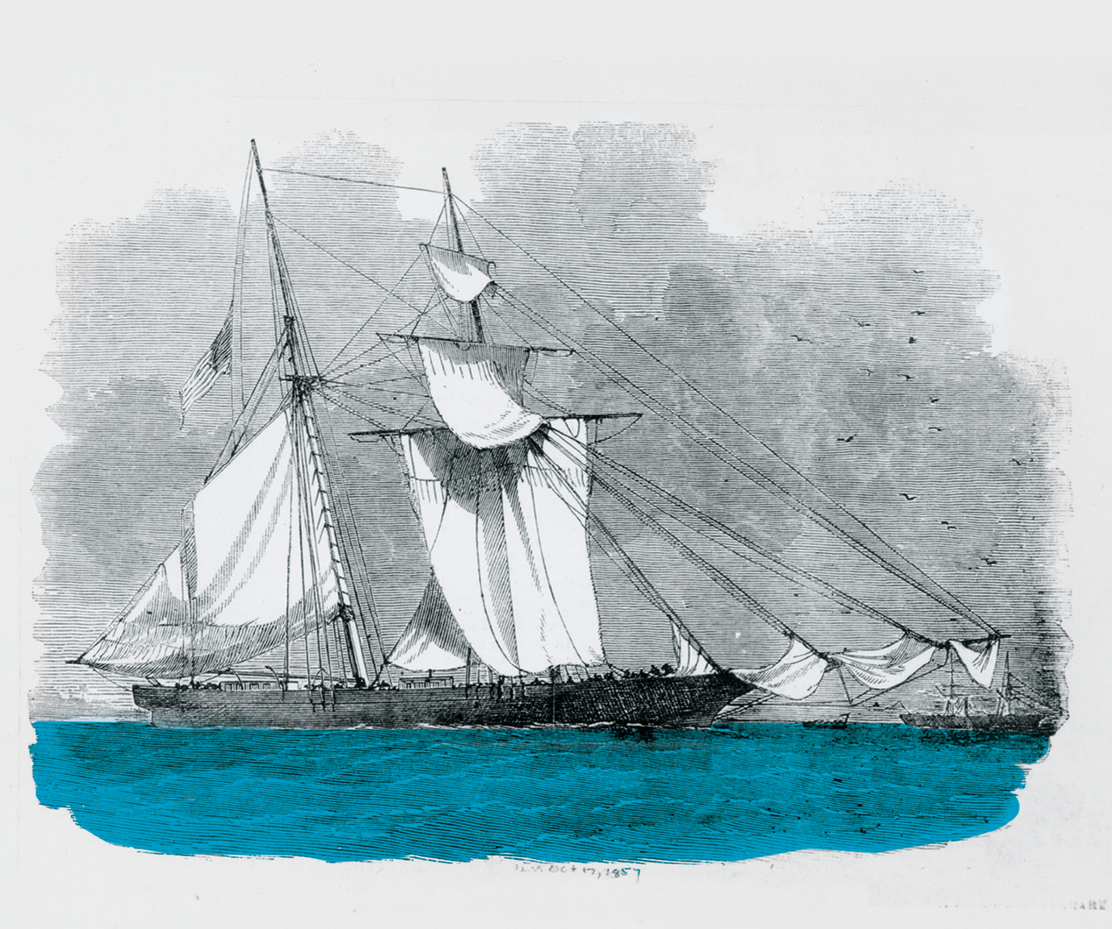
The Antelope
23 U.S. 66 (1825) (Marshall, C.J.)

Slide 28
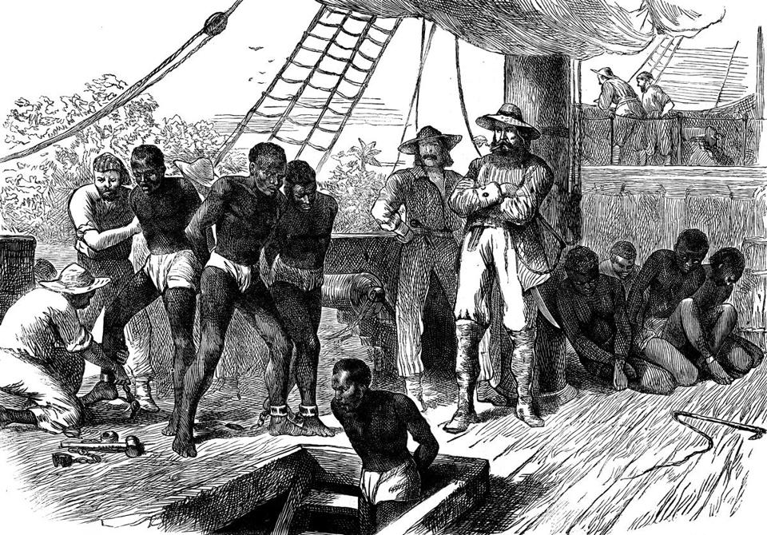
Claimants
Spanish
Portuguese
United States
Captain Jackson
Captain Smith

